Slide 1
ESTONIA
April 10 & 11 2024

Slide 2
Introduction to overall EU regulatory framework supporting best practices to fight AMR.
Estonia, 10th-11th April 2024

Slide 3
Objective
Introduction to the main provisions included in the new regulations in relation to the prudent use of antimicrobials

Slide 4
Content
EU Action Plan on AMR
EU Farm-to-fork strategy
Animal Health Law (Regulation (EU) 2016/429 on transmissible animal disease
EU framework on veterinary medicinal products (Regulation (EU) 2019/6) and medicated feed (Regulation (EU) 2019/4)

Slide 5
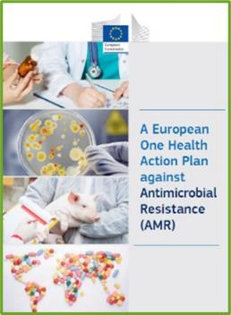


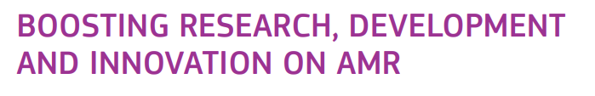

1. EU Action Plan on AMR
The key objectives of this plan are built on three main pillars:
    http://ec.europa.eu/health/amr/antimicrobial-resistance_en

Slide 6
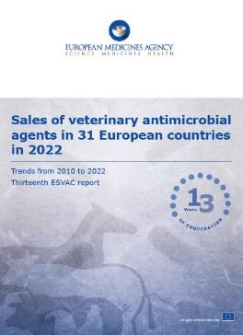
2. EU Farm-to-fork strategy
‘to reduce overall EU sales of antimicrobials for farmed animals and in aquaculture by 50% by 2030’
The ESVAC report included, for the first time, information on the progress towards the European Commission’s Farm to Fork Strategy target. In only four years, between 2018 and 2022, the 27 EU Member States achieved a 33,5 mg/PCU reduction, more than half of the 50% reduction target set for 2030.

Slide 7
3. Animal Health Law (Regulation (EU) 2016/429 of the EP and on transmissible animal disease)
“Prevention is better than cure”
Preventive driven approach:
improvement of animal health and biosecurity measures, good farming practices
Clear responsibility for all players for animal health
  Operators → ensure a high level of animal health and welfare, and biosecurity
  Vets → raise awareness and help in the prevention and spread of pathogens
  CA → protect animal health, human
  health and environment
Prioritising EU intervention
Regulatory tools/interventions for resistant pathogens: "disease agents“
Disease preventive and control measures may apply (surveillance, eradication etc.)
Legal basis monitoring AMR in animal pathogens

Slide 8
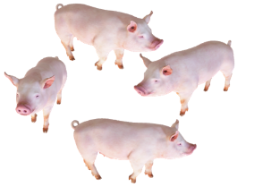

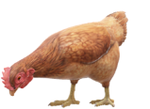




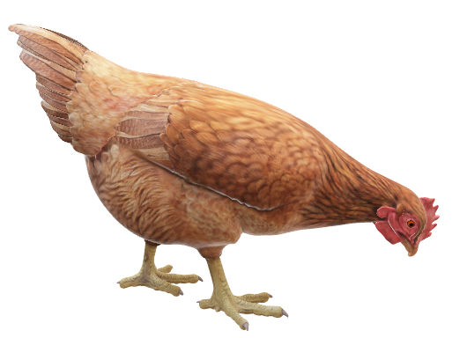



Uses of antimicrobials other than to treat sick animals
Prophylaxis
Metaphylaxis
When antimicrobials are administered to animals at risk of an infection or disease
A measure taken to maintain health and prevent infection or disease from occurring
When antimicrobials are administered to animals with clinical signs and to clinically healthy animals belonging to the same flock or pen
Some of the infections are treated before their clinical appearance
HEALTH
Start of the infectious disease
DISEASE
No symptoms
symptoms
early
conventional
Preventive
Curative treatment / control
Notes:
Prophylaxis: The word comes from the Greek for "an advance guard," an apt term for a measure taken to fend off a disease or another unwanted consequence. A prophylactic is a medication or a treatment designed and used to prevent a disease from occurring, before the disease is evidenced.
In the context of VMP Regulation the following definitions apply:
Prophylaxis’ means “the administration of a medicinal product to an animal or group of animals before clinical signs of a disease, in order to prevent the occurrence of disease or infection”. (Article 4(16) of Regulation (EU) 2019/6).
Metaphylaxis’ means “the administration of a medicinal product to a group of animals after a diagnosis of clinical disease in part of the group has been established, with the aim of treating the clinically sick animals and controlling the spread of the disease to animals in close contact and at risk and which may already be subclinically infected”. (Article 4(15) of Regulation (EU) 2019/6).
Metaphylaxis: Treatment of a group of animals without evidence of disease, which are in close contact with other animals that do have evidence of infectious disease
Prophylaxis/prevention and metaphylaxis involves administering antimicrobials to 'healthy' individuals to 'prevent' infections, but for prophylaxis/prevention there is a perceived 'risk', whereas metaphylaxis could be a definable 'hazard'

Slide 9

4. EU framework on veterinary medicinal products and medicated feed
Regulation (EU) 2019/6 on Veterinary Medicinal Products (VMP Regulation)
Prophylaxis
Only in exceptional cases, for the administration to an individual animal (antibiotics) or a restricted number of animals (other antimicrobials) when the risk of an infection or of an infectious disease is very high and the consequences are likely to be severe.
Metaphylaxis
Only when the risk of spread of an infection or of an infectious disease in the group of animals is high and where no other appropriate alternatives are available.
Member States may provide guidance regarding such other appropriate alternatives and shall actively support the development and application of guidelines which promote the understanding of risk factors associated with metaphylaxis and include criteria for its initiation.

Slide 10
4. EU framework on veterinary medicinal products and medicated feed
Regulation (EU) 2019/6 on Veterinary Medicinal Products (VMP Regulation)
Veterinary medicinal products shall be used in accordance with the terms of the marketing authorization.
All veterinary prescriptions should be based on a clinical examination or other proper assessment by a veterinarian
List of antimicrobials reserved for humans only*
Obligation for Member States to collect data on sale and use of antimicrobials
Commission Implementing Regulation (EU) 2022/1255 of 19 July 2022 designating antimicrobials or groups of antimicrobials reserved for treatment of certain infections in humans, in accordance with Regulation (EU) 2019/6 of the European Parliament and of the Council

Slide 11

4. EU framework on veterinary medicinal products and medicated feed
Regulation (EU) 2019/4 on Medicated Feed (MF Regulation)
Ban on the use of MF with antimicrobials for preventive treatment or growth promotion
  Requirement for diagnosis of disease prior to the required prescription for MF
  Limitation on the duration of a treatment and validity of prescription

Slide 12
4. EU framework on veterinary medicinal products and medicated feed
Regulation (EU) 2019/4 on Medicated Feed (MF Regulation)
  Establishment of EU wide, science-based limits for residual levels of the major antimicrobials in non-target compound feed.
  Measures to increase the quality of medicated feed production (more precise dosage) to avoid subtherapeutic exposure.

Slide 13


Upcoming Delegated and Implementing Legal Acts
A list of substances used in veterinary medicinal products authorised in the Union for use in food-producing terrestrial animal species or substances contained in a medicinal product for human use authorised in the Union in accordance with Directive 2001/83/EC or Regulation (EC) No 726/2004, which may be used in food-producing aquatic species in accordance with Article 114(1)
A list of substances which are essential for the treatment of equine species, or which bring added clinical benefit compared to other treatment options available for equine species and for which the withdrawal period for equine species shall be six months.

Slide 14
Prudent Use Guidelines
No legally binding as the previous acts/provisions!
Guideline for the prudent use of
antimicrobials in veterinary medicine 2015/C 299/04​
https://health.ec.europa.eu/system/files/2016-11/2015_prudent_use_guidelines_en_0.pdf
Best-practice framework for the use of antimicrobials in food-producing animals in the EU - Reaching for the next level.
https://epruma.eu/home/best-practice-guides/best-practice-framework-for-the-use-of-antimicrobials-in-food-producing-animals-in-the-eu-reaching-for-the-next-level/

Slide 15
Thank you!

