Slide 1
ESTONIA
10 & 11 April 2024

Slide 2
Important elements included in the new regulations, on VMP & MF and national related legislation and/or guidelines to be considered by veterinarians & farmers (II) Lecture 4
Estonia, 10th-11th April 2024

Slide 3
Objective
To present the provisions with regards to the use of antimicrobial medicinal products and for prophylaxis, metaphylaxis, treatment and for medicated feed.
The lists of antimicrobials that can be used in general, specific circumstances or for specific species or in certain conditions.
National regulations or guidelines will also be presented.

Slide 4
Content
Use of Antimicrobial Veterinary Medicinal Products
  Prophylaxis / Metaphylaxis / Treatment
  The list of antimicrobials reserved for treatment of certain infections in humans (‘reserve list’)
  The list of antimicrobials which may not be used outside the terms of their marketing authorisations (‘cascade use’) or to be used subject to certain conditions
  The list of antimicrobials for specific species (i.e., equine species and aquatic animals)
  The use of medicated feed containing antimicrobials
  Disposal of Veterinary Medicines
National legislation / national guidelines on use of Antimicrobial Veterinary Medicinal Products

Slide 5
Use of Antimicrobial Veterinary Medicinal Products
EU legislative framework: Regulation (EU) 2019/6 on VETERINARY MEDICINAL PRODUCTS (VMP)
PROPHYLAXIS / METAPHYLAXIS / TREATMENT
Prophylaxis use Article 107 (3)
Metaphylaxis use Article 107 (4)
Ban Systematic Prophylaxis

Slide 6
Use of Antimicrobial Veterinary Medicinal Products
PROPHYLAXIS
the administration of a medicinal product to an animal or group of animals before clinical signs of a disease, in order to prevent the occurrence of disease or infection
Principles for the use of prophylaxis (Article 107 (3))
Only in exceptional cases
For the administration to an individual animal (antibiotics) or a restricted number of animals (other antimicrobials)
When the risk of an infection or of an infectious disease is very high and the consequences are likely to be severe
Ban on Systematic Prophylaxis

Slide 7
Use of Antimicrobial Veterinary Medicinal Products
PROPHYLAXIS
!CHALLENGES
How to group the animals, a single animal in the group or several individually?
How do we justify the treatment of animals without clinical signs of the disease?
What happens with subclinical diseases?
What alternative measures can be put in place to prevent these situations and improve prevention and disease control?

Slide 8
Use of Antimicrobial Veterinary Medicinal Products
METHAPHYLAXIS
the administration of a medicinal product to a group of animals after a diagnosis of clinical disease in part of the group has been established, with the aim of treating the clinically sick animals and controlling the spread of the disease to animals in close contact and at risk and which may already be subclinically infected
Ban on Systematic Methaphylaxis
Principles for the use of methaplylaxis (Article 107 (4))
Only in exceptional use
Clinical disease in part of the group has been established
Only animals in close contact and at risk
The risk of spread of an infection or of an infectious disease in the group of animals is high
No other appropriate alternatives are available

Slide 9
Use of Antimicrobial Veterinary Medicinal Products
METHAPHYLAXIS
!CHALLENGES
The risk of infection of animals in contact with sick animals is too high and there are no suitable alternatives available
How do we justify the treatment?
Are appropriate alternatives available?
Member States may provide guidance regarding such other appropriate alternatives and shall
actively support the development and application of guidelines which promote the understanding
of risk factors associated with metaphylaxis and include criteria for its initiation.

Slide 10
Use of Antimicrobial Veterinary Medicinal Products
EU legislative framework: Regulation (EU) 2019/6 on VETERINARY MEDICINAL PRODUCTS (VMP)
Supporting prudent use and preserving efficacy
antimicrobials or groups of antimicrobials reserved for treatment of certain infections in humans.
!Article 37 (5)
“humans reserve list”
List of antimicrobials which:
are not to be used in accordance with Articles 112, 113 and 114; or
(b) are only to be used in accordance with Articles 112, 113 and 114 subject to certain conditions.
!Article 107 (6)
“ use of AM outside the marketing authorisation”

Slide 11
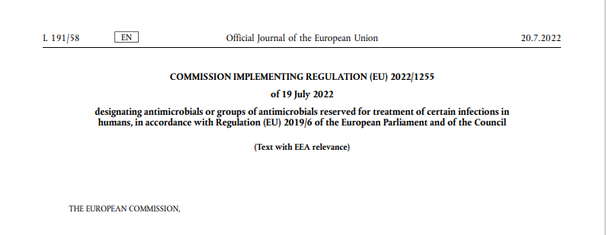
Use of Antimicrobial Veterinary Medicinal Products
Supporting prudent use and preserving efficacy
! The list of antimicrobials reserved for treatment of certain infections in humans (‘human reserve list’)
“reserve list”
The antimicrobials and group of antimicrobials listed in this Regulation should not be used in veterinary medicinal products.
VMP that contain antimicrobials or groups of antimicrobials listed in this Regulation in medicated feed should not be possible.
The list of antimicrobials or groups of antimicrobials to be reserved for treatment of certain infections in humans should be kept under continual review in the light of new scientific evidence or emerging information
Commission Implementing Regulation (EU) 2022/1255

Slide 12
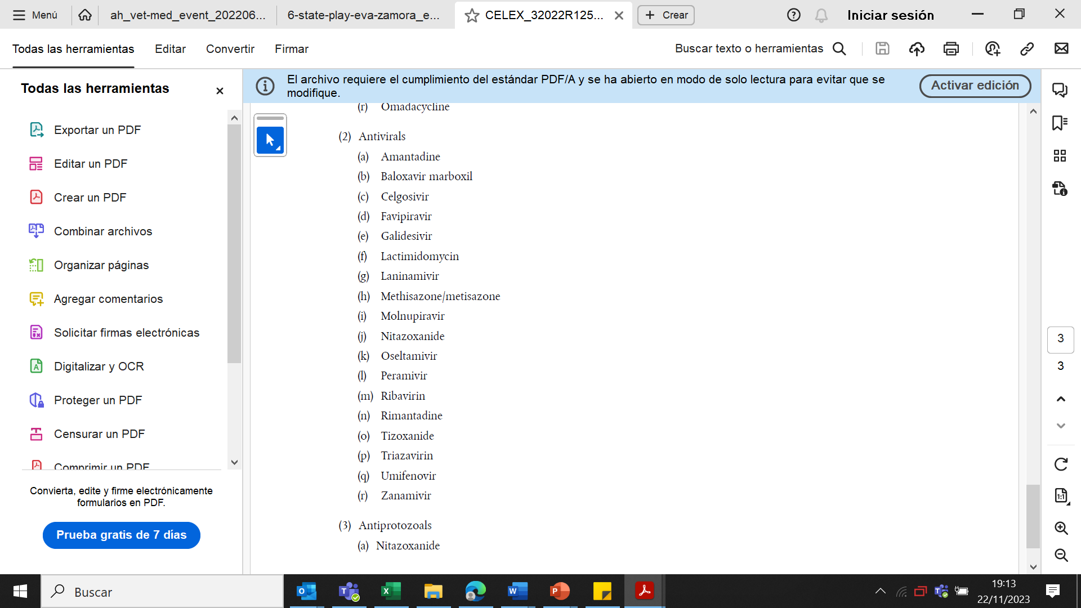
Use of Antimicrobial Veterinary Medicinal Products
“human reserve list”
Supporting prudent use and preserving efficacy
Commission Implementing Regulation (EU) 2022/1255

Slide 13
Use of Antimicrobial Veterinary Medicinal Products
Supporting prudent use and preserving efficacy
!Article 107(6)
List of antimicrobials which:
  are not to be used in accordance with Articles 112, 113 and 114; or
  are only to be used in accordance with Articles 112, 113 and 114 subject to certain conditions.
“use of AM outside
the marketing authorisation”

Slide 14

Use of Antimicrobial Veterinary Medicinal Products
Supporting prudent use and preserving efficacy
The list of antimicrobials for specific species (aquatic animals)
!Article 114
The Commission is to establish, by means of implementing acts, a list of substances used in veterinary medicinal products authorised in the Union for use in food-producing terrestrial animal species or substances contained in a medicinal product for human use authorised in the Union in accordance with Directive 2001/83/EC or Regulation (EC) No 726/2004, which may be used in food-producing aquatic species in accordance with Article 114(1).

Slide 15

Use of Antimicrobial Veterinary Medicinal Products
Supporting prudent use and preserving efficacy
2006
2013
Commission Regulation (EC) No 1950/2006 and Regulation (EC) No 122/2013 –List of substances essential form the treatment of equidae

Slide 16

Use of Antimicrobial Veterinary Medicinal Products
Supporting prudent use and preserving efficacy
The list of antimicrobials for specific species (equine species)
The Commission is to establish a list of substances which are essential for the treatment of equine species, or which bring added clinical benefit compared to other treatment options available for equine species and for which the withdrawal period for equine species shall be six months.
On the 9 February 2023, the European Medicines Agency (EMA, the Agency) received from the European Commission a request to provide scientific advice for the establishment this list of substances.
The CVMP adopted the survey at its meeting held 18-20 April 2023. The survey, was available until 30 June 2023. The deadline for submission of the advice has been recently extended by 31 July 2024.

Slide 17
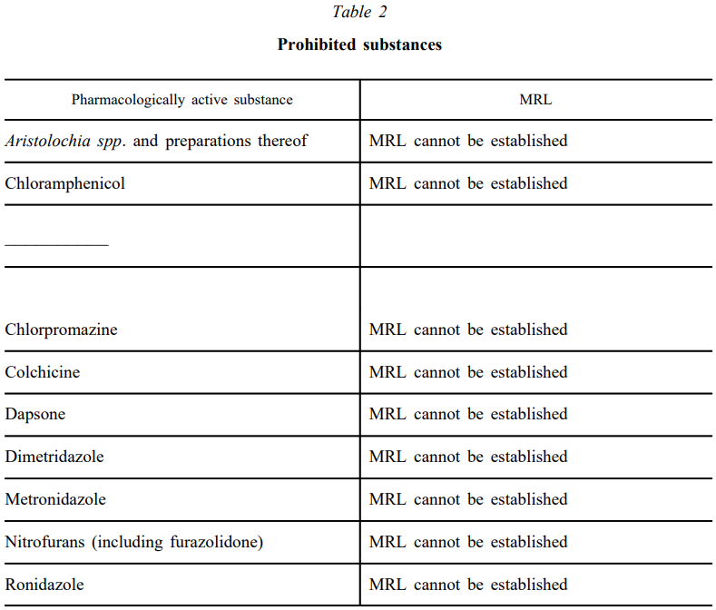
Use of Antimicrobial Veterinary Medicinal Products
Supporting prudent use and preserving efficacy
The list of antimicrobials for specific species (equine species)
Three activities were identified in EC’s mandate:
Review the existing entries in the current list (i.e. in Regulation (EU) 1950/2006, as amended by Regulation (EU) 122/2013);
Carry out a survey on the possible need to add other substances as a result of newly available evidence and the need for updating the information on use, advantages and alternatives of the entries in the current list;
Consider substances included in Table 2 of Annex to Commission Regulation (EU) No 37/210, unless there are concerns related to consumer protection.
The expert group appointed by the CVMP discussed and adopted the survey. The assessment work is still ongoing.

Slide 18
Use of Antimicrobial Veterinary Medicinal Products
EU legislative framework: Regulation (EU) 2019/4 on MEDICATED FEED (MF)
Principles for the use of medicated feed
  Ban on the use of MF with antimicrobials for prophylaxis.
  Requirement for diagnosis of disease prior to the mandatory prescription for MF.
  Limitation on the duration of a treatment and validity of prescription.
  Reduce any potential synergy between feed medication carry-over residues and occurrence of antimicrobial resistance.
  Measures to increase the quality of medicated feed production (more precise dosage) to avoid subtherapeutic exposure.
  Maximum levels of cross-contamination for 24 antimicrobial active substances in non-target feed.
Ban Systematic Prophylaxis

Slide 19
Disposal of Veterinary Medicine
EU legislative framework
Regulation (EU) 2019/4 on MEDICATED FEED (MF)
EU legislative framework Regulation (EU) 2019/6 on VETERINARY MEDICINAL PRODUCTS (VMP)
European Union Strategic Approach to Pharmaceuticals in the Environment COM (2019)128
Pharmaceutical waste means used, unused or expired veterinary medicines or medicated feed containing medicinal products, including their immediate packaging
PharmaceuticalWasteDisposal.pdf (epruma.eu)
Waste may be found at the veterinarian, pharmacist, or medicated feed manufacturer’s level, as well as at animal keepers’ level including farms, breeders, kennels and pets and other animal owners.

Slide 20
Disposal of Veterinary Medicine
How and where does pharmaceutical waste occur?
Immediate packaging and the remains of medicines within after use.
VMP or MF that are past their expiry date or that have not been stored in accordance with the instructions.
Prescription of a quantity exceeding the required quantity or uncompleted course of treatment due to either administration difficulties, adverse reactions, change in treatment or because animals died during treatment.
FACTSHEET_PharmaceuticalWasteDisposal.pdf (epruma.eu)

Slide 21
Disposal of Veterinary Medicine
Best practices for disposal
PharmaceuticalWasteDisposal.pdf (epruma.eu)
Everybody (prescribers and users) is responsible for minimising pharmaceutical waste.
Disposal of pharmaceutical waste via waterways should be excluded.
Pharmaceutical waste should be stored in a dedicated container, bin, or facility to ensure adequate protection to animal health, human health, feed, food and the environment and this must be separated from any stocks of veterinary medicines to ensure that the waste cannot be inadvertently used.
Waste must be disposed of in accordance with the Summary of Product Characteristics (SPC) and the waste legislation and national systems developed in consultation with all parties for the collection, transport, and disposal of the waste.
Member States shall ensure that appropriate collection or discard systems are in place for waste veterinary medicinal products (including medicated feed) and to ensure that the location of collection or discard points as well as other relevant information is made available to farmers, animal keepers, veterinarians, and other relevant persons.

Slide 22

Estonian specifications

Slide 23
National guidelines on use of Antimicrobial Veterinary Medicinal Products
Guidelines for antibiotic treatment for productive animals
Continuing education courses for veterinarians and farmers
Studies on antibiotic resistance in microbes
Notes:
Add more slides if necessary

