Slide 1
Hands-on training for farmers and veterinarians:
Group exercises
LITHUANIA 25 SEPTEMBER 2024

Slide 2
“Prevention is better than cure”
Part I
Global need: reduction Antimicrobial resistance
New regulatory framework
Preventive measures to be implemented at farm level
Part II
Changes at farm level: Common understanding between farmers and veterinarians
Notes:
The second part of the hands-on-training focuses on the idea of “Prevention is better than cure”. Farmers and veterinarians will work together exploring changes at farm level as preventive measures to reduce the need of reducing antimicrobial use. These implies that a common understanding between farmers and veterinarians is needed.

Slide 3
“Prevention is better than cure”
Let’s work together to prevent and reduce the use of antimicrobials…
By creating action points on YOUR (client’s) farm
Notes:
“Lets work together to prevent and reduce the use of antimicrobial”.

Slide 4
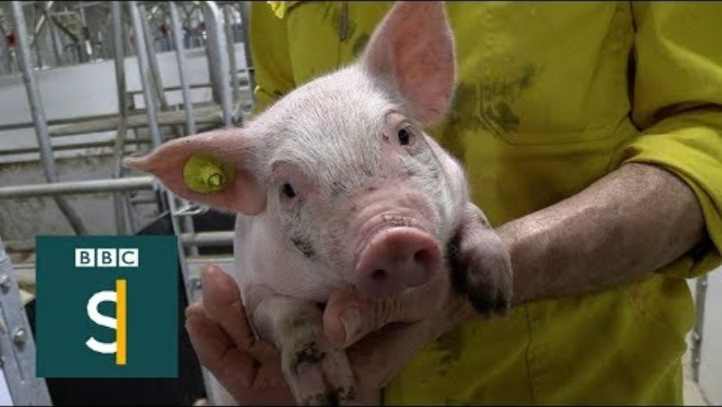
WHY?
Notes:
https://www.youtube.com/watch?v=jFuQqwBmN8A

Slide 5
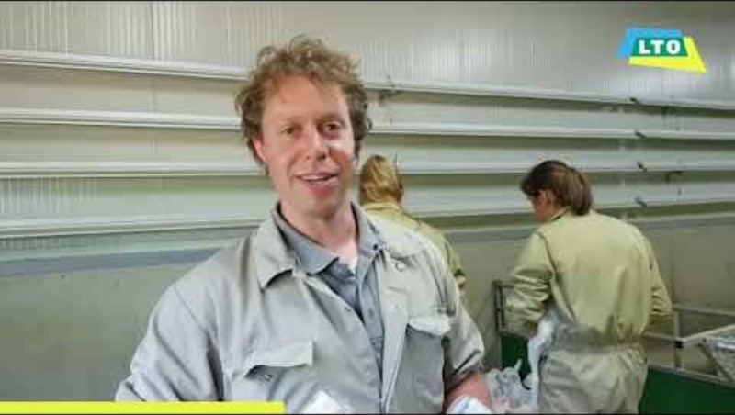
Foster collaboration between farmers and veterinarians
There is more and more collaboration between the farmer and the veterinarian to improve animal health and to reduce the use of antimicrobials on farm level…Because it is effective!
The aim for today is to identify common key areas in which farmers and veterinarians can collaborate, which leads to further improvement.
Notes:
https://www.youtube.com/watch?v=cu7cIIlbOd8
Rational: A strong and well-established relationship between farmers and veterinarians forms the cornerstone for implementing effective measures at farm level to prevent and reduce the use of antimicrobials. It is therefore crucial to identify common key areas in which they can collaborate to foster trust between veterinarians and farmers. When both groups are able to identify the problems and solutions, this will set a strong basis for improvement.

Slide 6
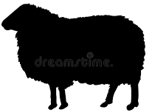
We will do the following group exercises:
GE 1
Identify problems and opportunities
Group exercise 1
Identify problems and opportunities
husbandry practices
to reduce and responsible use of antimicrobials
Problems& opportunities of farmers identified
Problems & opportunities of veterinarians identified
Group exercise 2
Find solutions to address barriers
2 a
2 b
to improve husbandry practices
to reduce and responsible use of antimicrobials
GE 2a
Identify
GE 2b
Group exercise 3
Sharing, presenting outcomes
3 a
3 b
GE 3a
List husbandry practices
Measures to reduce and responsible use of antimicrobials
GE 3b
Notes:
The activity will consist in agreeing action points at farm level, measures that are personally valuable to both farmers and veterinarians.
In other countries: Farmers and veterinarians in separate groups
The aim of the exercise is to identify different challenges and opportunities observed in the field that impact the implementation of best practices and further reduction of AMU, such as husbandry conditions, disease situation, biosecurity, animal health visits, diagnostic testing, prescription and use of antimicrobials, etc. The findings of this GE1 will serve as a basis for GE2a and GE2b.

Slide 7
Announcement
After group exercise 2a and 2b, you will be asked to write down a SMART action point for yourself – to be implemented on your / your client’s farm
For example:
By analyzing the blood and slaughter line test results and adjusting the vaccination policy accordingly, there will be no cough in weanling piglets within 2 months.

Slide 8
Group exercise 1
Identify problems and opportunities
35
MIN
Please, answer to the following questions:
What are the most used antimicrobials in your specie and for which conditions?
What are the opportunities/good practices to reduce AMU for these conditions?
Husbandry practices
Reduce and responsible use of antibiotics
Other
Work with post-its to put your answers on the flip-overs
Notes:
In other countries: Farmers and veterinarians in separate groups
The aim of the exercise is to identify different challenges and opportunities observed in the field that impact the implementation of best practices and further reduction of AMU, such as husbandry conditions, disease situation, biosecurity, animal health visits, diagnostic testing, prescription and use of antimicrobials, etc. The findings of this GE1 will serve as a basis for GE2a and GE2b.

Slide 9
Group exercise 2a - Identify the barriers and find solutions to address barriers – husbandry practices
Farmers and veterinarians mixed in 1 group, divided per specie
Take the flip-over of previous group exercise: husbandy practices
Take a new flip-over to answer the questions:
What are the barriers to implementing the husbandry practices identify in the exercise 1?
What are the solutions to address these barriers?
Create a SMART goal for yourself - to be implemented on your / your client’s farm
Work with post-its to put your answers on the flip-overs
35
MIN
Notes:
Topics for discussion (non-exhaustive):
o Hygiene practices
o Biosecurity measures
o Nutrition
o Animal welfare
o Vaccines schemes
o Other management measures

Slide 10
Group exercise 2b - Find solutions to address barriers –Reduce and responsible use of antimicrobials
Farmers and veterinarians mixed in 1 group, divided per specie
Take the flip-over of previous group exercise: Reduce and responsible use of antimicrobials
Take a new flip-over to answer the questions:
What are the barriers to reducing and responsible use of antimicrobials?
What are the solutions to address these barriers?
Create a SMART goal for yourself - to be implemented on your / your client’s farm
Work with post-its to put your answers on the flip-overs
35
MIN
Notes:
Topics for discussion (non-exhaustive):
o Hygiene practices
o Biosecurity measures
o Nutrition
o Animal welfare
o Vaccines schemes
o Other management measures

Slide 11
Group exercise 3a: Presentation of the outcomes: solutions to improved husbandry practices
Each table addresses one presenter
“In what way can improved husbandry practices contribute to the reduction of AMU?”
Each presenter presents one outcome of his/her table session
Then we continue to the next table – mention an outcome that haven’t been mentioned before!
30
MIN
Notes:
Presenter will often be one of the trainers
In case there is remaining time for discussion:
Questions:
What are the similarities with the outcomes of your sector?
What are the differences?
What raises questions? / What stands out?

Slide 12
Group exercise 3b: Presentation of the outcomes: measures to reduce and use antimicrobials in a more responsible way
Each table addresses one presenter
“In what way can other measures to be implemented contribute to the reduction of AMU?”
Each presenter presents one outcome of his/her table session
Then we continue to the next table – mention an outcome that haven’t been mentioned before!
30
MIN
Notes:
Presenter will often be one of the trainers
In case there is remaining time for discussion:
Questions:
What are the similarities with the outcomes of your sector?
What are the differences?
What raises questions? / What stands out?

