Slide 1
Regulation (EU) 2019/6:
major tool for addressing AMR
AMRFV Training
6 November 2024 – Plovdiv
Luben Goranov, Veterinary Medicines Unit
DG Health and Food Safety (SANTE)

Slide 2
The VMP Regulation in context
European Commission
Who we are
?
What we do, and how
And... what the (not so) new EU regulation on veterinary medicinal products brings

Slide 3
DG Health and Food Safety – DG SANTE
Our mission:
"Making healthy and safe EU citizens the engine of sustainable economic growth"
In practice, our mission requires that we:
improve and protect human health
ensure that all food and medicinal products are safe
protect animal health and welfare, and plant health
How the VMP Regulation contributes to these general objectives

Slide 4
Breaking New Ground
Reducing administrative burden
Access to data
Contribution to the F2F objectives
Modern & innovative
Fit-for-purpose
Fight AMR
Transparency
Increased availability
Streamlined procedures & processes
Limited markets
Promote innovation

Slide 5
Antimicrobial Resistance: A Global threat
Burden of AMR
Economic cost
Projections from 2025 to 2050¹:
39 million deaths attributable to AMR
169 million deaths associated with AMR
Cost to health systems:
≈ USD PPP 28.9 billion every year
Cost to the broader economies:
≈ USD PPP 36.9 billion²
¹ Naghavi et al., The Lancet 404.10459 (2024): 1199-1226. ² OECD, https://doi.org/10.1787/ce44c755-en.
PPP = Purchasing power parity

Slide 6
One Health concept
Zoonotic diseases
AMR
Food safety
Environment
Non-communicable diseases
“livestock hygiene is the people’s health”

Slide 7
Antimicrobial Resistance: the Bigger Picture
A forward-looking regulation
Ground-breaking policy measures to ensure prudent and responsible use of antimicrobials
Major tool to achieve the Strategy objective of halving overall Union sales of antimicrobials for farmed animals and in aquaculture by 2030

Slide 8
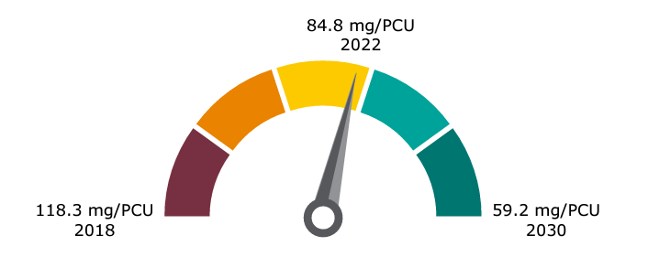
ESVAC: The Good News
Trends from 2017 to 2022¹ (in 31 participating countries):
overall sales declined by 30.7% (from 106.6 mg/PCU to 73.9 mg/PCU)
28.3% reduction in comparison to the 2018 reference value
¹ Sales of veterinary antimicrobial agents in 31 European countries in 2022, Trends from 2010 to 2022, Thirteenth ESVAC report

Slide 9
The Implementation Challenge
Applicable: 2 years, 8 months & 23 days, excluding today
Some 25 empowerments:
13 before or by the date of application
6 by 2025
1 by 2027
6 no legal deadline
Focus on completing the implementation, implementing & enforcement

Slide 10
VMP Regulation
IA Rules on the size of small immediate packaging units
IA Union Product Database
IA List of AM not to be used outside terms of MA
DA Requirements for the collection of data on sales and use of AM
DA Imports of animals and products of animal origin
DA Criteria to designate AM reserved for humans only
IA Good Pharmacovigilance Practice & PSMF
IA Abbreviations and pictograms for labelling
DA Annex II
IA Format for the collection of data on sales and use of AM
IA List of authorised third countries for imports into the Union
IA GDP VMPs
IA Common logo for online sales
IA List of variations not requiring assessment
IA List of AM reserved for human use only
IA GDP Active substances
DA Rules for VMP oral administration via drinking water or top dressing
IA amending import certificates
AHL
DA Horse passport
IA Horse passport

Slide 11
VMP Regulation
No legal deadline for adoption
IA Model format for prescriptions
IA Rules for the functioning of the worksharing procedure
Work in progress
IA List of substances for food-producing aquatic species
IA List of substances essential for equine species
IA GMPs for
VMPs, autogenous vaccines
& active substances
DA Procedures for financial penalties for CAs VMP
IA Uniform rules on the identification code

Slide 12
Where can one follow progress?
On our dedicated web page:
https://europa.eu/!rJ63kT or QR code
Where can one provide feedback?
On the Have Your Say platform:
https://ec.europa.eu/info/law/better-regulation/have-your-say

Slide 13
Thank you
© European Union 2023
Unless otherwise noted the reuse of this presentation is authorised under the CC BY 4.0 license. For any use or reproduction of elements that are not owned by the EU, permission may need to be sought directly from the respective right holders.
Slide xx: element concerned, source: e.g. Fotolia.com; Slide xx: element concerned, source: e.g. iStock.com
Notes:
Update/add/delete parts of the copy right notice where appropriate.
More information: https://myintracomm.ec.europa.eu/corp/intellectual-property/Documents/2019_Reuse-guidelines%28CC-BY%29.pdf

