Slide 1
POLAND
21 & 22 OCTOBER 2024

Slide 2
Important elements of the new EU Medicated Feed Regulations
Lecture 3
POLAND 21 & 22 OCTOBER 2024

Slide 3
EU legal framework on veterinary medicinal products/medicated feed
Regulation (EU) 2019/6 on Veterinary Medicinal Products
Regulation (EU) 2019/4 on Medicated Feed

Slide 4
EU legal framework on veterinary medicinal products/medicated feed
Regulation (EU) 2019/6 on Veterinary Medicinal Products
Regulation (EU) 2019/4 on Medicated Feed

Slide 5
Common rules – Veterinary prescription
Common rules
MEDICATION VIA FEED OR WATER
Different rules apply for
Oral Medication
(on-farm mixing in feed or water by the animal keeper)
Via Feed
Via Water
Medicated Feed
(feed mixed with medicines in feed mill or mobile mixer or via special equipped vehicle by feed business operator )
Reg. (EU) 2019/4
(MF)
Reg. (EU) 2019/6 (VMP)
& Commission Delegated Reg. (EU) 2024/1159
Notes:
Therefore, the delegated act on oral medication applies to veterinary medicinal products administered orally by means of mixing into or addition onto feed and to the mixing of veterinary medicinal products in drinking water or in liquid feed by the animal keeper. It should not apply to the mixing of a veterinary medicinal product into feed by feed business operators irrespectively of whether they operate in a feed mill, with a mobile mixer or an on-farm mixer, which is covered by Regulation (EU) 2019/4.
(f) ‘mobile mixer’ means a feed business operator with a feed establishment consisting of a specifically equipped vehicle for the manufacture of medicated feed; (g) ‘on-farm mixer’ means a feed business operator manufacturing medicated feed for the exclusive use on its farm;

Slide 6
Use of Antimicrobial Veterinary Medicinal Products
EU legislative framework: Regulation (EU) 2019/4 on MEDICATED FEED (MF)
Principles for the use of medicated feed
Ban on the use of MF with antimicrobials for prophylaxis.
Requirement for diagnosis of disease prior to the mandatory prescription for MF.
Limitation on the duration of a treatment and validity of prescription.
Reduce any potential synergy between feed medication carry-over residues and occurrence of antimicrobial resistance.
Measures to increase the quality of medicated feed production (more precise dosage) to avoid subtherapeutic exposure.
Maximum levels of cross-contamination for 24 antimicrobial active substances in non-target feed.
Ban Systematic Prophylaxis

Slide 7
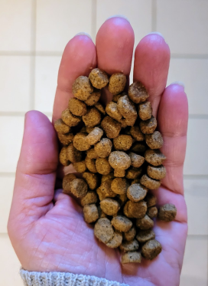
Common rules – Veterinary prescription
Common rules
Veterinary prescriptions in relation to medicated feed (1/2)
Reg.(EU) 2019/4
Article 16
Medicated feed (animal feed mixed with medicines by feed business operator) requires:
a veterinary prescription
can only be issued after clinical examination or any other proper assessment of the health status of the animals
only for diagnosed diseases (except for vaccines and parasitics)
Watch out for interactions with other medications!
Notes:
1. The supply of medicated feed to animal keepers shall be subject to:
(a) the presentation and, in case of manufacturing by on-farm mixers, the possession of a veterinary prescription for medicated feed; and
(b) the conditions laid down in paragraphs 2 to 10.
2. A veterinary prescription for medicated feed shall be issued only after a clinical examination or any other proper assessment of the health status of the animal or group of animals by a veterinarian and only for a diagnosed disease.
3. By way of derogation from paragraph 2, a veterinary prescription for medicated feed containing immunological veterinary medicinal products may be issued also in the absence of a diagnosed disease.
4. By way of derogation from paragraph 2, if it is not possible to confirm the presence of a diagnosed disease, a veterinary prescription for medicated feed containing antiparasitics without antimicrobial effects may be issued based on
the knowledge of the parasite infestation status in the animal or group of animals.

Slide 8
Common rules – Veterinary prescription
Common rules
Veterinary prescriptions in relation to medicated feed (2/2)
Reg.(EU) 2019/4
Article 16
Record keeping: Veterinary prescriptions should be kept by feed mill and the veterinarian prescribing & animal keeper for 5 years
1 prescription = 1 veterinary treatment
Maximum duration of treatment: 2 weeks for antibiotics, 1 month for other medicines
Validity prescription: max 5 days for feed with antimicrobial, max 3 weeks for other medicines for food-producing animals, rest 6 months
Notes:
6. The veterinary prescription for medicated feed shall contain the information set out in Annex V. The original veterinary prescription for medicated feed shall be kept by the manufacturer or, where appropriate, the feed
business operator supplying the medicated feed to the animal keeper. The veterinarian, or the professional person referred to in paragraph 5, issuing the prescription and the keeper of food-producing or fur animal shall keep a copy of the veterinary prescription for medicated feed. The original and copies shall be kept for five years from the date of issuance.
7. With the exception of medicated feed for non-food-producing animals, other than fur animals, medicated feed shall not be used for more than one treatment under the same veterinary prescription for medicated feed.
The duration of a treatment shall comply with the summary of product characteristics of the veterinary medicinal product incorporated in the feed and, where not specified, shall not exceed one month, or two weeks in case of a medicated feed
containing antibiotic veterinary medicinal products.
8. The veterinary prescription for medicated feed shall be valid from the date of its issuance for a maximum period of six months for non-food-producing animals other than fur animals and three weeks for food-producing animals and fur
animals. In the case of medicated feed containing antimicrobial veterinary medicinal products, the prescription shall be valid from the date of its issuance for a maximum period of five days.
9. The veterinarian issuing the veterinary prescription for medicated feed shall verify that that medication is justified for the target animals on veterinary grounds. Furthermore that veterinarian shall ensure that the administration of the
veterinary medicinal product concerned is not incompatible with another treatment or use and that there is no contraindication or interaction where several medicinal products are used. In particular, the veterinarian shall not prescribe
medicated feed with more than one veterinary medicinal product containing antimicrobials.
10. The veterinary prescription for medicated feed shall:
(a) comply with the summary of the product characteristics of the veterinary medicinal product, except for veterinary
medicinal products intended to be used in accordance with Article 112, Article 113 or Article 114 of Regulation (EU)
2019/6;
(b) indicate the daily dose of the veterinary medicinal product which is to be incorporated in a quantity of medicated feed
that ensures the uptake of the dosage by the target animal considering that the feed uptake of diseased animals might
differ from a normal daily ration;
(c) ensure that the medicated feed containing the dosage of the veterinary medicinal product corresponds to at least 50 %
of the daily feed ration on a dry matter basis and that, for ruminants, the daily dose of the veterinary medicinal
product is contained in at least 50 % of the complementary feed except for mineral feed;
(d) indicate the inclusion rate of the active substances, calculated on the basis of the relevant parameters.
11. Veterinary prescriptions for medicated feed issued in accordance with paragraphs 2, 3 and 4 shall be recognized throughout the Union.
12. The Commission may, by means of implementing acts, set a model format for the information set out in
Annex V. That model format shall also be made available in electronic version. Those implementing acts shall be
adopted in accordance with the examination procedure referred to in Article 21(2).

Slide 9
POLAND
specifications

Slide 10
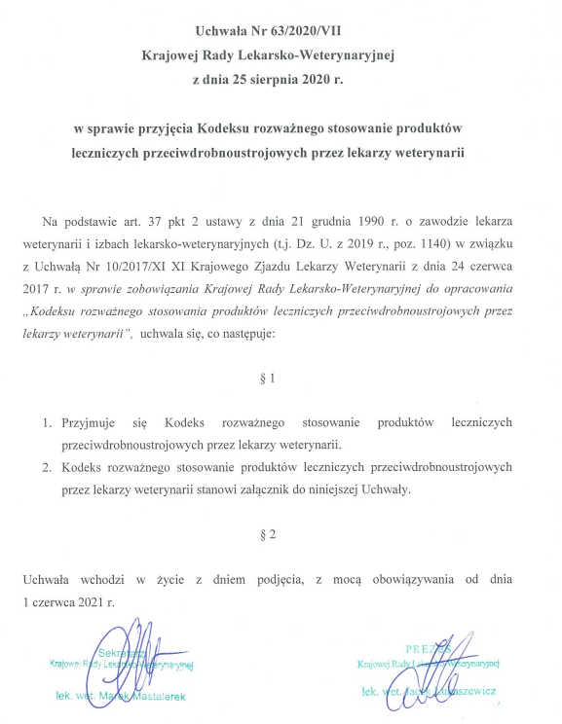
POLAND – national provisions
Zasady ogólne
Regulation (EU) 2019/4
CODE OF THE PRUDENT USE OF ANTIMICROBIAL MEDICINAL PRODUCTS BY VETTERINARIANS
Resolution No. 63/2020/VII of the National Veterinary Medical Council of August 25, 2020.
https://vetpol.org.pl/wp-content/uchwaly/VII_kadencja/Kodeks_stosowania_antybiotyk%C3%B3w.pdf
Poultry
Pigs
Cattle
Horses
Rabbits
Companion animals
-> Categorization of antibiotics for use in animals according to: EMA

Slide 11
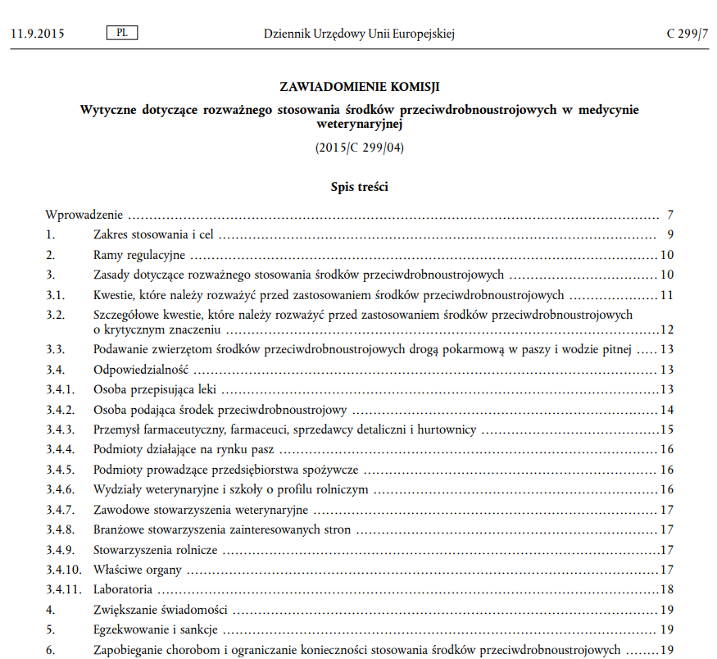
POLAND – national provisions
Zasady ogólne
Regulation (UE) 2019/6
Commission Notice — Guidelines for the prudent use of antimicrobials in veterinary medicine
(2015/C 299/04)
https://health.ec.europa.eu/document/download/190841e8-5975-4390-a304-908c259592ab_pl?filename=2015_prudent_use_guidelines_pl.pdf

Slide 12
POLAND – national provisions
Zasady ogólne
Regulation (UE) 2019/4
Act of December 1, 2022 amending the Feed Act and the Waste Act (Journal of Laws 2022, item 2722) https://isap.sejm.gov.pl/isap.nsf/DocDetails.xsp?id=WDU20220002722
on manufacturing,
placing on the market and
use of medicated feed
Objective: The need to implement into national law the provisions of Regulation (EU) 2019/4 of the European Parliament and of the Council of 11 December 2018
Intended effect: the need to maintain Poland's strong position in terms of the competitiveness of Polish animal products on foreign markets; other detailed regulations (concerning entities producing medicinal feed, including mobile feed factories, regarding requirements for medicinal products, etc.)
Notes:
1. the reason for undertaking work on amending the Act on Feed is the need to implement into national law the provisions of Regulation (EU) 2019/4 of the European Parliament and of the Council of 11 December 2018 on the production, placing on the market and use of medicated feed;
2. and the need to maintain Poland's strong position in terms of the competitiveness of Polish animal products on foreign markets.
3. it also specifies the conditions that must be met by entities operating on the feed market and the regulations under which they can produce medicated feed.
4. Objective - to ensure homogeneity and requirements to prevent cross-contamination of non-target feed with active substances derived from veterinary medicinal products.
5. Regulation 2019/4 allows the production of medicated feed in mobile medicated feed plants.

Slide 13
Thank you

