Slide 2
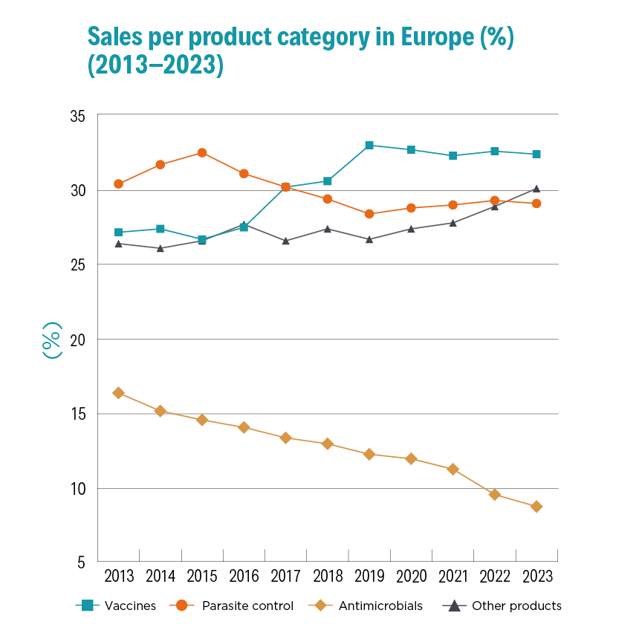
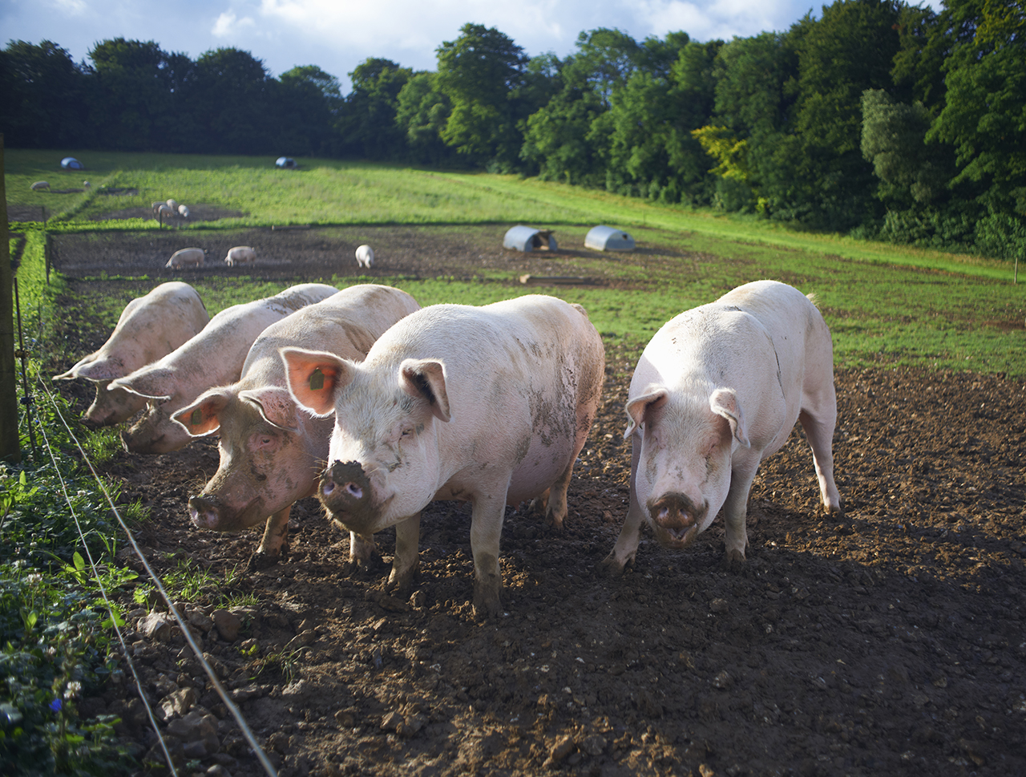
Sales of prevention products are increasing across Europe.Also the biggest segment in Poland (1/3)
This shows a concerted effort for more preventive care on farms.
Disease prevention approaches in farming can also reduce the need for antibiotic use.

Slide 3
VAC (vaccines): Largest product segment in Poland, accounts for more than 1/3 of sales. Value growth of 31% (2019-2022).
AB (antibiotics): Represent almost 1/6 of WPL's sales. Up 8% in absolute terms, but market share down from 22% to 17% (2019-2022).
Positive trend: Decrease in percentage share of ABs considered favorable, although ESVAC data for Poland indicate the need for further work.
Customers: Animal breeders are the main customers of AB and VAC.
Conclusion: VAC sales growth faster than AB, in line with “prevention is better than cure.”
Sales by category of veterinary medicinal products in Poland (PLN) (2008-2022)
Szczepionki
Środki
przeciwdrobnoustrojowe
Kontrola pasożytów
Inne produkty

Slide 4
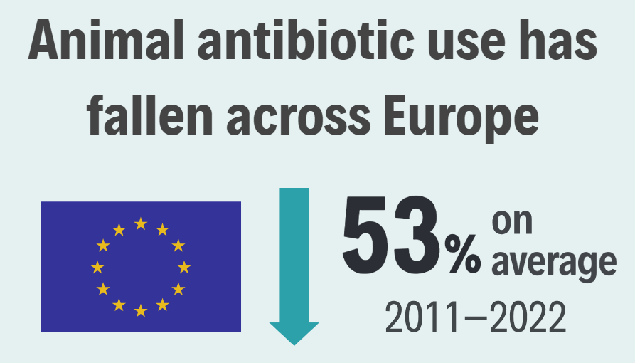
Sales of antibiotics for animal health purposes have decreased across Europe.
In some major livestock-producing countries across Europe antimicrobial sales have fallen more than 50%.
Steep declines in sales levelling off to a consistent level may reflect a state of ‘optimal use’ where prevention is optimised, but antibiotics remain necessary for treatment of disease that eludes preventive measures.

Slide 5
There is limited veterinary use of priority antimicrobial classes*.
Very rarely, some may need to be used to treat specific bacterial infections in animals, for which there is no alternative treatment: many cannot be used in animals at all.
Large reductions have been reported across Europe for EMA priority veterinary antimicrobial classes.
*AMEG category B: EMA/AMEG 2019, Categorisation of antibiotics in the European Union

Slide 6
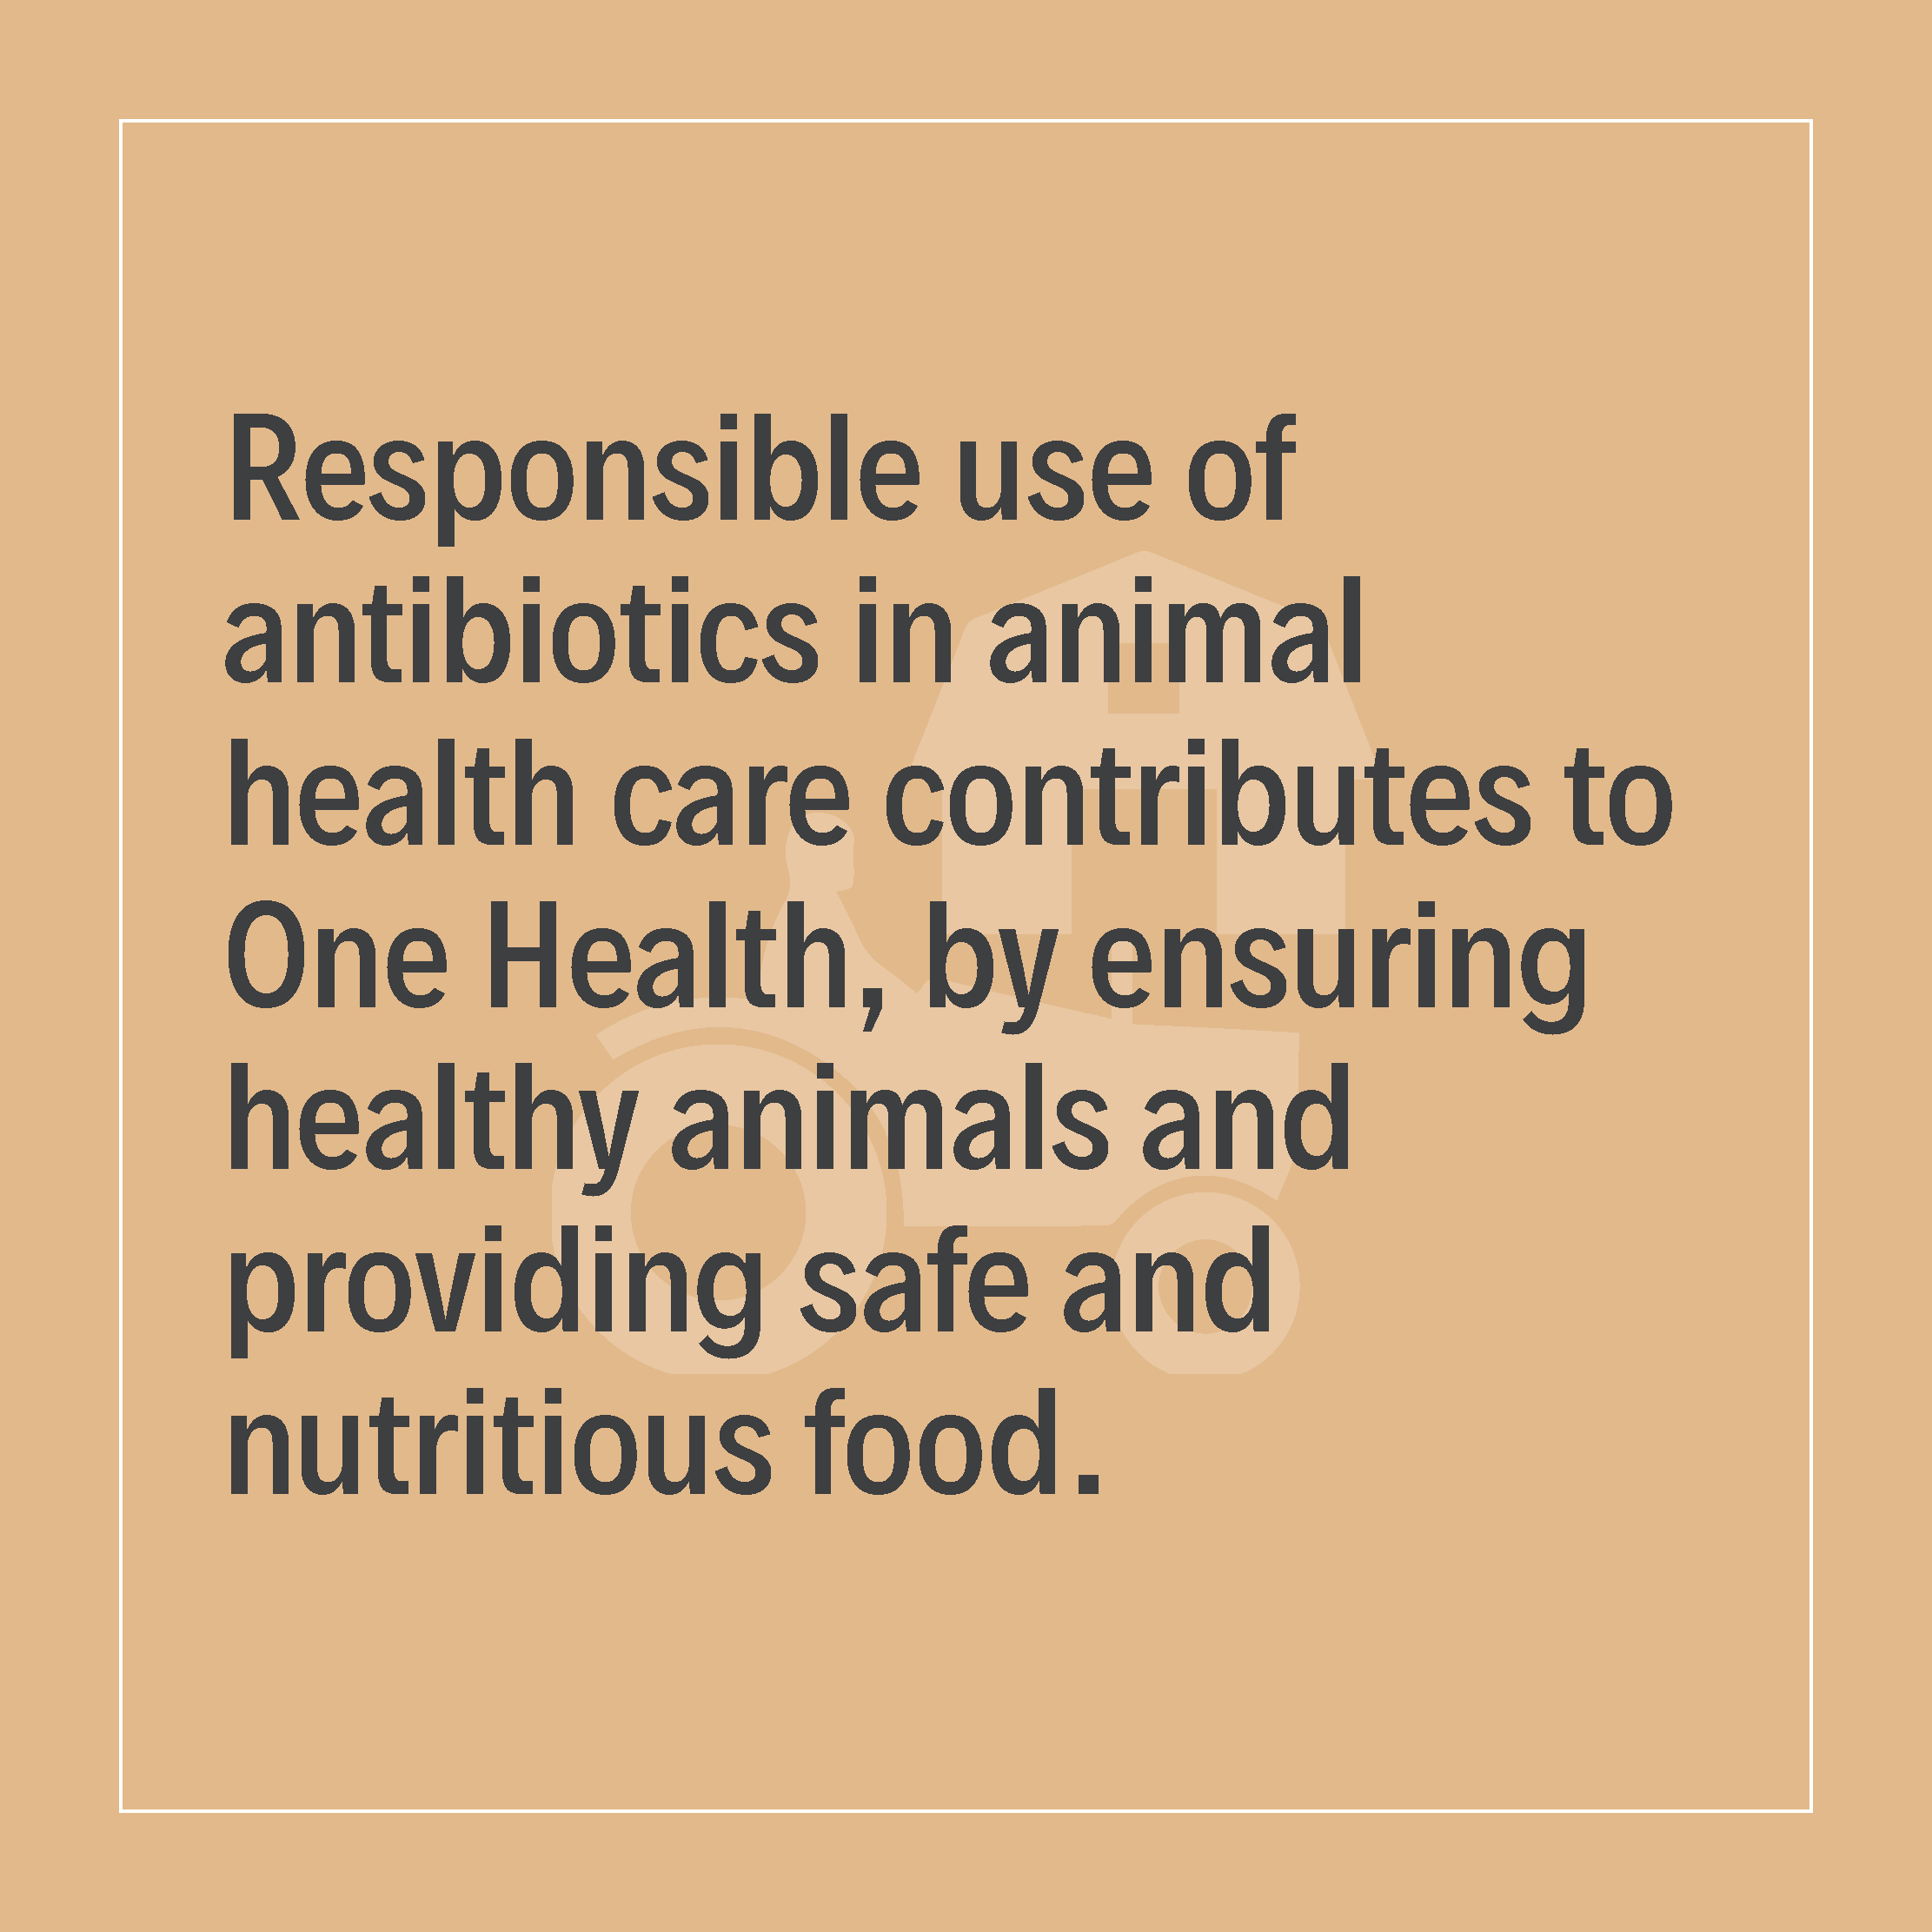
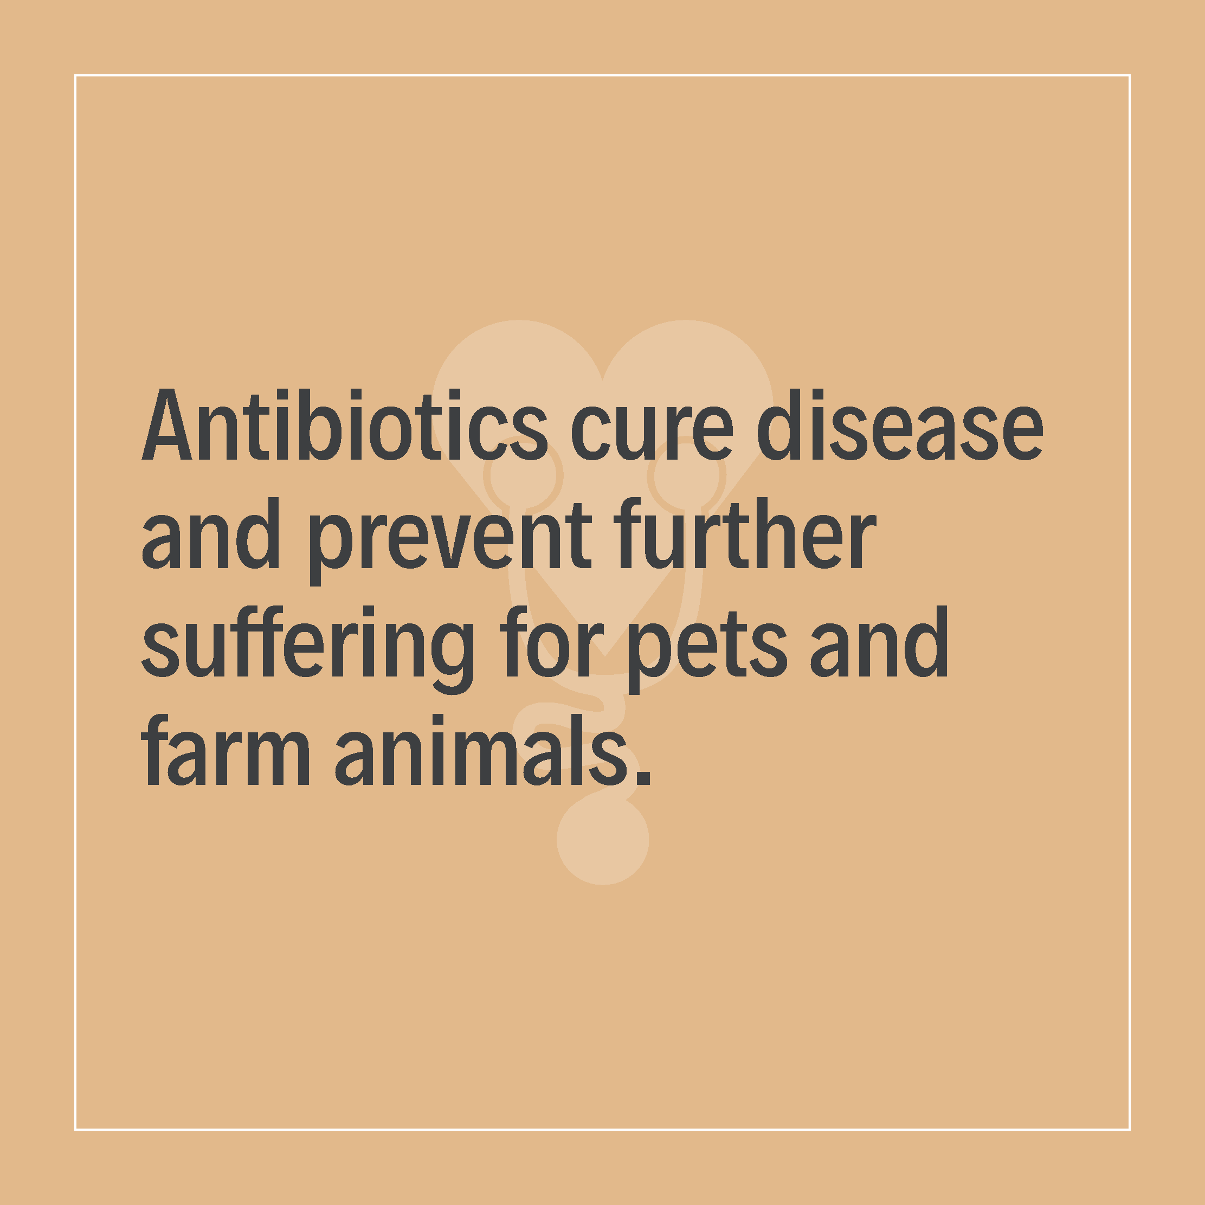
Disease prevention and holistic animal care are central to good antibiotic stewardship.
However, antibiotics will always be needed for veterinarians, farmers and other animal owners to treat bacterial infections in animals.
No like-for-like alternatives exist currently to cure bacterial infection.

Slide 7
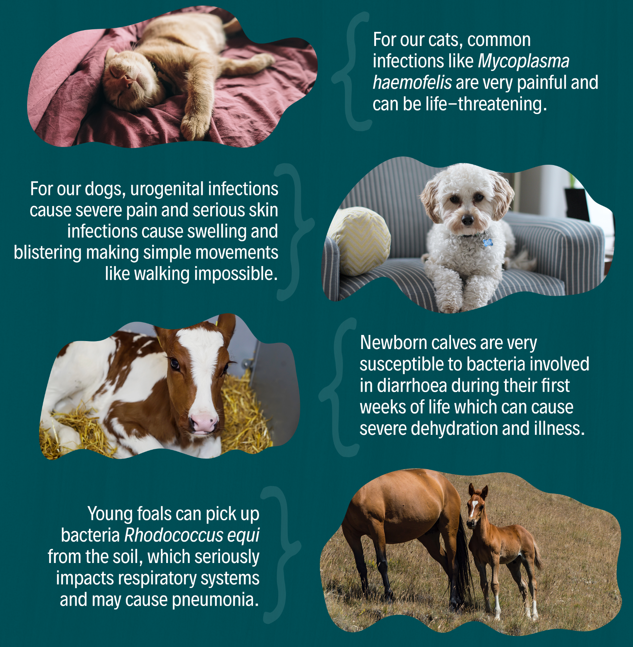
No matter how well they are cared for, animals can get life-threatening illnesses which can only be treated by specific antibiotics.
A range of therapeutic options are necessary to ensure that animals are not left unprotected which could cause unnecessary suffering and death.

Slide 9
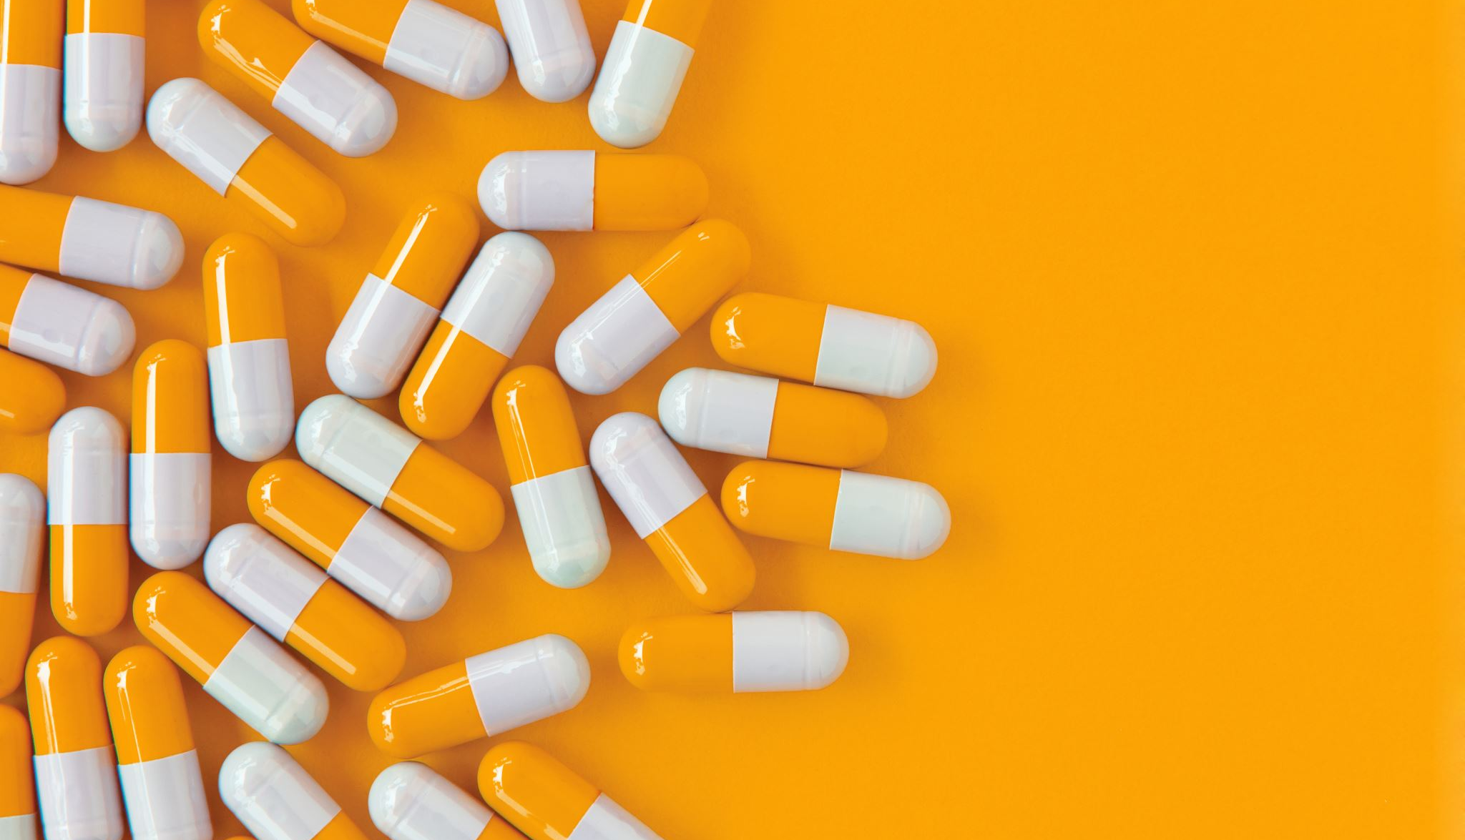
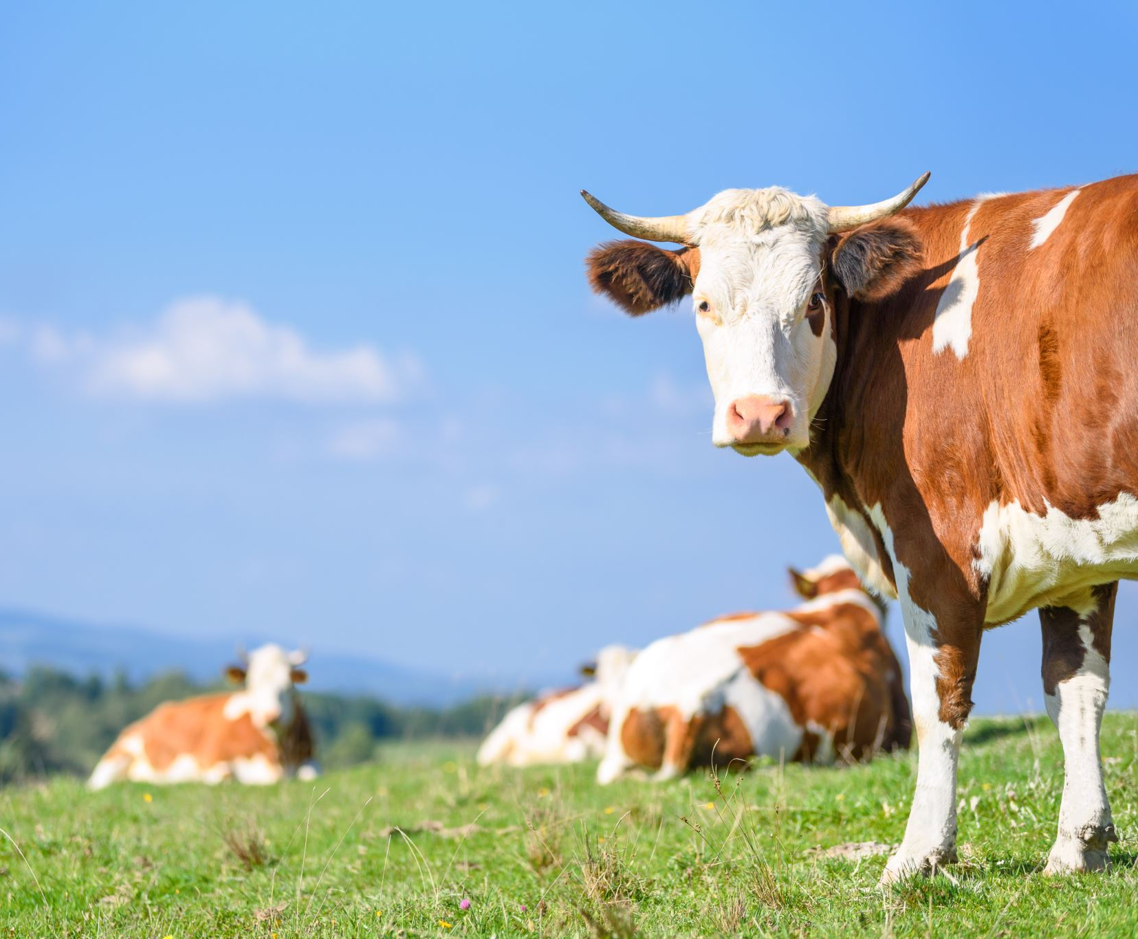
Biggest challenges in developing new antibiotics
-Bacterial resistance - rapid adaptation of bacteria to new drugs, increase in the number of resistant strains. -Test complexity - lengthy and expensive in vitro and in vivo testing, requiring complex clinical trials. -High costs - billions of dollars in research expenditures and low profitability of antibiotics. -Regulation - long approval process by regulatory agencies, strict safety standards. -Limited market - low profitability and low demand for “last resort” antibiotics. -Responsible use - need to limit use to prevent resistance. -Environmental consequences-impact on public health and environmental pollution. -Lack of new therapeutic targets - limited number of new mechanisms of action, other priorities. -Lack of innovation - few new classes of antibiotics, mainly modifications of existing drugs. -Lack of funding - insufficient financial and political support for research into new antibiotics.
Notes:
The development of new antibiotics faces a number of serious challenges that make the process long, expensive and difficult. Here are the biggest of these:
1. increasing bacterial resistance
-Mechanisms ofresistance: Bacteria are rapidly evolving and developing resistance mechanisms to existing antibiotics, which reduces the effectiveness of new drugs. The introduction of a new antibiotic carries the risk that resistance will emerge shortly after introduction.
-Superbugs: The increase in the number of bacterial strains resistant to multiple drugs (so-called superbugs) further complicates the antibiotic development process, as new drugs must be uniquely effective against such pathogens.
2 The complexity of preclinical and clinical research
-Antibiotic research requires specific in vitro and in vivo tests that differ from research on other types of drugs. The difficulty lies in accurately predicting how new antibiotics will work in complex biological environments and under different clinical conditions.
-Animal and human clinical trials : Antibiotics must undergo rigorous safety and efficacy testing, which often requires testing on different animal species and groups of patients with different types of infections. This increases the time and cost of clinical trials.
3. high research and development costs
-The process of discovering, developing and bringing a new antibiotic to market is extremely expensive. It is estimated that it can cost billions of dollars to fully develop a new antibiotic.
-Additionally, the low profitability of antibiotics compared to other drugs (e.g., drugs for chronic diseases) often makes pharmaceutical companies reluctant to invest in this area. Antibiotics are typically used for a short period of time, and their responsible use (to prevent resistance) limits profits.
4 Regulation and lengthy approval process
-Tightregulation: Bringing an antibiotic to market requires going through a complex regulatory process that can take many years. Regulatory agencies, such as the FDA, EMA and URPL, must carefully evaluate all aspects of a new drug, including its impact on public health and the environment.
-Riskof withdrawal: Even after approval, drugs may be withdrawn if they are found to have undesirable side effects or if resistance to them spreads faster than expected.
5 Limited market and low profitability.
-Antibiotics are often seen as “last resort” drugs and used only in critical situations, meaning sales of new antibiotics may be limited.
-Additionally, pressure for responsible use of antibiotics (targeted antibiotic therapy, limiting prophylactic use) reduces the potential market, which discourages investors.
6 Responsible use and long product life cycle
-New antibiotics must be used with extreme caution to minimize the risk of rapid development of resistance. This, in turn, limits their widespread use in treatment, which reduces the potential revenue and profitability from their sale.
-Veterinarywithdrawal requirementsand use restrictions mean that antibiotics are often marketed with many restrictions.
7 Environmental and health consequences of antibiotic use.
-There is growing pressure to reduce the use of antibiotics, especially in agriculture and veterinary medicine, because of their impact on public health and the environment (e.g., antibiotics leaking into groundwater, spread of resistant bacteria).
-Several rigorous studies are needed to show that a new antibiotic does not contribute to environmental pollution and that its use in animal husbandry does not affect human health.
8 Shortage of new therapeutic targets
-Unlike other areas of pharmacology, such as oncology or chronic diseases, there are a limited number of new molecular targets in antibiotic development. Most current antibiotics act on well-known mechanisms, such as bacterial cell wall synthesis or DNA replication. Discovering completely new mechanisms of action for antibiotics is difficult and rare.
9. lack of innovation in antibiotic research
-The pharmaceutical industry has for many years focused on optimizing existing classes of antibiotics, rather than looking for completely new ones. This means that many new antibiotics are merely modifications of existing drugs, limiting their long-term effectiveness.
10. lack of funding and political support
-Despite the fact that the problem of antibiotic resistance is a global public health threat, governments and international organizations often do not allocate sufficient funding for research into new antibiotics. The lack of strong financial and political support mechanisms hinders progress in this area.
Summary
The development of new antibiotics is a complex, costly and time-consuming process, affected by both technical difficulties in research and issues related to bacterial resistance and a small market. Successfully addressing these challenges requires support at multiple levels, from innovative research to policy and regulatory initiatives that support the responsible use of antibiotics.

