Slide 1
CZECH REPUBLIC
21 & 22 NOVEMBER 2024

Slide 2
Important elements of the new EU Medicated Feed Regulations
Lecture 3
CZECH REPUBLIC, 21 & 22 NOVEMBER 2024

Slide 3
EU legal framework on veterinary medicinal products/medicated feed
Regulation (EU) 2019/6 on Veterinary Medicinal Products
Regulation (EU) 2019/4 on Medicated Feed

Slide 4
Common rules – Veterinary prescription
Common rules
MEDICATION VIA FEED OR WATER
Different rules apply for
Oral Medication
(on-farm mixing in feed or water by the animal keeper)
Via Feed
Via Water
Medicated Feed
(feed mixed with medicines in feed mill or mobile mixer or via special equipped vehicle by feed business operator )
Reg. (EU) 2019/4
(MF)
Reg. (EU) 2019/6 (VMP)
& Commission Delegated Reg. (EU) 2024/1159
Notes:
Therefore, the delegated act on oral medication applies to veterinary medicinal products administered orally by means of mixing into or addition onto feed and to the mixing of veterinary medicinal products in drinking water or in liquid feed by the animal keeper. It should not apply to the mixing of a veterinary medicinal product into feed by feed business operators irrespectively of whether they operate in a feed mill, with a mobile mixer or an on-farm mixer, which is covered by Regulation (EU) 2019/4.
(f) ‘mobile mixer’ means a feed business operator with a feed establishment consisting of a specifically equipped vehicle for the manufacture of medicated feed; (g) ‘on-farm mixer’ means a feed business operator manufacturing medicated feed for the exclusive use on its farm;

Slide 5
Use of Antimicrobial Veterinary Medicinal Products
EU legislative framework: Regulation (EU) 2019/4 on MEDICATED FEED (MF)
Principles for the use of medicated feed
Ban on the use of MF with antimicrobials for prophylaxis.
Requirement for diagnosis of disease prior to the mandatory prescription for MF.
Limitation on the duration of a treatment and validity of prescription.
Reduce any potential impact of cross contamination/carry-over residues of antimicrobials from MF on occurrence of antimicrobial resistance.
Measures to increase the quality of medicated feed production (targeted on achievement of more precise dosage) to avoid subtherapeutic exposure.
Maximum levels of cross-contamination for 24 antimicrobial active substances in non-target feed.
Ban Systematic Prophylaxis

Slide 6
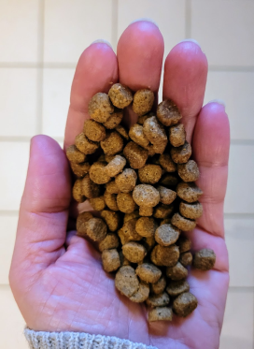
Common rules – Veterinary prescription
Common rules
Veterinary prescriptions in relation to medicated feed (1/2)
Reg.(EU) 2019/4
Article 16
Medicated feed (animal feed mixed with medicines by feed business operator) requires:
a veterinary prescription
can only be issued after clinical examination or any other proper assessment of the health status of the animals
only for diagnosed diseases (except for vaccines and parasitics)
Watch out for interactions with other medications!
Notes:
1. The supply of medicated feed to animal keepers shall be subject to:
(a) the presentation and, in case of manufacturing by on-farm mixers, the possession of a veterinary prescription for medicated feed; and
(b) the conditions laid down in paragraphs 2 to 10.
2. A veterinary prescription for medicated feed shall be issued only after a clinical examination or any other proper assessment of the health status of the animal or group of animals by a veterinarian and only for a diagnosed disease.
3. By way of derogation from paragraph 2, a veterinary prescription for medicated feed containing immunological veterinary medicinal products may be issued also in the absence of a diagnosed disease.
4. By way of derogation from paragraph 2, if it is not possible to confirm the presence of a diagnosed disease, a veterinary prescription for medicated feed containing antiparasitics without antimicrobial effects may be issued based on
the knowledge of the parasite infestation status in the animal or group of animals.

Slide 7
Common rules – Veterinary prescription
Common rules
Veterinary prescriptions in relation to medicated feed (2/2)
Reg.(EU) 2019/4
Article 16
Record keeping: Veterinary prescriptions should be kept by feed mill and the veterinarian prescribing & animal keeper for 5 years
1 prescription = 1 veterinary treatment
Maximum duration of treatment: 2 weeks for antibiotics, 1 month for other medicines
Validity prescription: max 5 days for feed with antimicrobial, max 3 weeks for other medicines for food-producing animals, rest 6 months
Notes:
6. The veterinary prescription for medicated feed shall contain the information set out in Annex V. The original veterinary prescription for medicated feed shall be kept by the manufacturer or, where appropriate, the feed
business operator supplying the medicated feed to the animal keeper. The veterinarian, or the professional person referred to in paragraph 5, issuing the prescription and the keeper of food-producing or fur animal shall keep a copy of the veterinary prescription for medicated feed. The original and copies shall be kept for five years from the date of issuance.
7. With the exception of medicated feed for non-food-producing animals, other than fur animals, medicated feed shall not be used for more than one treatment under the same veterinary prescription for medicated feed.
The duration of a treatment shall comply with the summary of product characteristics of the veterinary medicinal product incorporated in the feed and, where not specified, shall not exceed one month, or two weeks in case of a medicated feed
containing antibiotic veterinary medicinal products.
8. The veterinary prescription for medicated feed shall be valid from the date of its issuance for a maximum period of six months for non-food-producing animals other than fur animals and three weeks for food-producing animals and fur
animals. In the case of medicated feed containing antimicrobial veterinary medicinal products, the prescription shall be valid from the date of its issuance for a maximum period of five days.
9. The veterinarian issuing the veterinary prescription for medicated feed shall verify that that medication is justified for the target animals on veterinary grounds. Furthermore that veterinarian shall ensure that the administration of the
veterinary medicinal product concerned is not incompatible with another treatment or use and that there is no contraindication or interaction where several medicinal products are used. In particular, the veterinarian shall not prescribe
medicated feed with more than one veterinary medicinal product containing antimicrobials.
10. The veterinary prescription for medicated feed shall:
(a) comply with the summary of the product characteristics of the veterinary medicinal product, except for veterinary
medicinal products intended to be used in accordance with Article 112, Article 113 or Article 114 of Regulation (EU)
2019/6;
(b) indicate the daily dose of the veterinary medicinal product which is to be incorporated in a quantity of medicated feed
that ensures the uptake of the dosage by the target animal considering that the feed uptake of diseased animals might
differ from a normal daily ration;
(c) ensure that the medicated feed containing the dosage of the veterinary medicinal product corresponds to at least 50 %
of the daily feed ration on a dry matter basis and that, for ruminants, the daily dose of the veterinary medicinal
product is contained in at least 50 % of the complementary feed except for mineral feed;
(d) indicate the inclusion rate of the active substances, calculated on the basis of the relevant parameters.
11. Veterinary prescriptions for medicated feed issued in accordance with paragraphs 2, 3 and 4 shall be recognized throughout the Union.
12. The Commission may, by means of implementing acts, set a model format for the information set out in
Annex V. That model format shall also be made available in electronic version. Those implementing acts shall be
adopted in accordance with the examination procedure referred to in Article 21(2).

Slide 8
Delegated Regulation (EU) 2024/1159 on Oral Administration
Lays down rules to ensure the effective and safe use of VMPs authorised and prescribed for oral administration via routes other than medicated feed and administered by the animal keeper to food-producing animal
To avoid reduction of effectiveness, resistance development, contamination
Covers VMPs in drinking water or mixed in or spread on feed by the animal owner. Does not cover medicated feed (also not if mixed by mobile mixer by feed operator on farm).
Important role for veterinarians – they should evaluate equipment, species, situation on the farm, etc before prescribing. They should also advise the owner on how to dose correctly and on correct disposal.
Important role for animal keeper: needs to properly store, prepare, have suitable equipment to administer and dispose of the leftovers. Ensure the feed/water is suitable. Ensure no contamination.
Notes:
SUPPLEMENTARY SLIDES TO USE IN CASE QUESTIONS CONCERNING ORAL MEDICATION COME UP
Oral medication has more risks of being ineffective than giving an individual treatment. So these extra rules are to avoid products losing effectiveness, to avoid the development and spread of resistance and to avoid contamination or unintended administration to non-target species or people or spread in the environment.
It covers all oral medication, except medicated feed mixed by a feed operator. This Regulation applies to authorised and prescribed veterinary medicinal products administered orally in drinking water, mixed into feed, or administered on the surface of feed immediately prior to feeding and administered by the animal keeper to food-producing animals
Veterinarians have a crucial role here: they need to know the situation on the farm, the equipment, the feed, etc before prescribing to be sure the VMP can be effectively given. They also need to advise the animal owner on how to dispose or remove remaining medicines.
- Oral administration of VMPs in solid feed can lead to animals competing for the same feed and give risk of underdosage and overdosage. This is especially important for antimicrobials and antiparasitics as it may lead to antimicrobial and antiparasitic resistance. Therefore, the prescription and oral administration of an antimicrobials or antiparasitics by mixing into solid feed or administration on the surface of solid feed immediately prior to feeding should only be allowed when the animals are fed individually or when the intake of the veterinary medicinal product by individual animals can be effectively controlled in a small group of animals.

Slide 9
Delegated Regulation (EU) 2024/1159 on Oral Administration
Lays down rules to ensure the effective and safe use of VMPs authorised and prescribed for oral administration via routes other than medicated feed and administered by the animal keeper to food-producing animal
The mixing of antibiotics or antiparasitics in solid feed should only be done fоr animals fed individually or for a small group of animals. MS may restrict those uses only to animals individually fed (if not harming animal health or welfare). Administration via drinking water for groups of animals is allowed.
EXCEPT - If medicated feed is not available, or waiting for delivery, it is allowed for aquatic animals to mix antimicrobials and antiparasitics in feed for group treatment
It is not allowed to administer several antimicrobials at the same time
Only on veterinary prescription based on a diagnosis and indicating the target species and the number of animals to be treated.
Be careful with biocides, feed additives or other substances used simultaneously, they can interact
Notes:
SUPPLEMENTARY SLIDES FOR IF SOME QUESTIONS COME ON THE DA ORAL MEDICATION
Oral medication has more risks of being ineffective than giving an individual treatment. So these extra rules are to avoid products losing effectiveness, to avoid the development and spread of resistance and to avoid contamination or unintended administration to non-target species or people or spread in the environment.
It covers all oral medication, except medicated feed mixed by a feed operator.
Veterinarians have a crucial role here: they need to know the situation on the farm, the equipment, the feed, etc before prescribing to be sure the VMP can be effectively given. They also need to advise the animal owner on how to dispose or remove remaining medicines.
- Oral administration of VMPs in solid feed can lead to animals competing for the same feed and give risk of underdosage and overdosage. This is especially important for antimicrobials and antiparasitics as it may lead to antimicrobial and antiparasitic resistance. Therefore, the prescription and oral administration of an antimicrobials or antiparasitics by mixing into solid feed or administration on the surface of solid feed immediately prior to feeding should only be allowed when the animals are fed individually or when the intake of the veterinary medicinal product by individual animals can be effectively controlled in a small group of animals.

Slide 10
Delegated Regulation (EU) 2024/1159 on Oral Administration
Lays down rules to ensure the effective and safe use of VMPs authorised and prescribed for oral administration via routes other than medicated feed and administered by the animal keeper to food-producing animal
MS may develop further national guidelines to facilitate the application of that Regulation.
Shall apply from 9 November 2025.
Notes:
SUPPLEMENTARY SLIDES FOR IF SOME QUESTIONS COME ON THE DA ORAL MEDICATION
Oral medication has more risks of being ineffective than giving an individual treatment. So these extra rules are to avoid products losing effectiveness, to avoid the development and spread of resistance and to avoid contamination or unintended administration to non-target species or people or spread in the environment.
It covers all oral medication, except medicated feed mixed by a feed operator.
Veterinarians have a crucial role here: they need to know the situation on the farm, the equipment, the feed, etc before prescribing to be sure the VMP can be effectively given. They also need to advise the animal owner on how to dispose or remove remaining medicines.
- Oral administration of VMPs in solid feed can lead to animals competing for the same feed and give risk of underdosage and overdosage. This is especially important for antimicrobials and antiparasitics as it may lead to antimicrobial and antiparasitic resistance. Therefore, the prescription and oral administration of an antimicrobials or antiparasitics by mixing into solid feed or administration on the surface of solid feed immediately prior to feeding should only be allowed when the animals are fed individually or when the intake of the veterinary medicinal product by individual animals can be effectively controlled in a small group of animals.

Slide 11
National provisions

Slide 12
Medicated feedingstuffs the Czech Republic - national legal provisions
According the Act No 314/2022 Coll., amending Act No 378/2007 Coll, on pharmaceuticals and on amendments of other related law
New division of competences among 2 national competent authorities:
Framework for supervision of manufacturing of medicated feedingstuffs and intermdiates:
moved to
Central Institute for Supervising and Testing in Agriculture since 1.12.2022
Ústřední kontrolní a zkušební ústav zemědělský (ÚKZÚZ)
Framework for supervision of prescription, handling, stocking, use of VMPs in medicated feed ant thier intermediates manufacture
continue to remain under
Institute for State Control of Veterinary Biologiecals and Medicines
Ústavu pro státní kontrolu veterinárních biopreparátů a léčiv (ÚSKVBL)

Slide 13
Medicated feed in the amendment to Act No 314/2022 Coll. - Part I (Impelementation of Regulation (EU) 2019/4, and (EU) 2019/6 whenever relevant)
§ 73
Medicated feed shall be prescribed on prescription form for medicated feed... Compliance with the conditions set out in Article 16 of Regulation (EU) 2019/4 of the European Parliament and of the Council
Only a VMP authorised in accordance with § 25, which is intended for use in MF in accordance with the decision on its authorisation , or a VMP for which an exemption has been granted for such use, may be prescribed for MF
An antimicrobial medicinal product shall be prescribed for MK only in accordance with the marketing authorisation decision and the conditions laid down in § 9a, mutatis mutandis. For the use of an antimicrobial medicinal product outside the terms of the marketing authorisation, the operator referred to in § 6 (1) letter (d) shall apply for an exemption, following the procedure laid down in § 48 mutatis mutandis.
...
(5) MK feed may only be used in accordance with the conditions laid down in the presription for medicated feed issued pursuant to paragraph 1 and other conditions laid down in Article 17 of Regulation (EU) 2019/4
Duties for farmer
(6) and (7) A farmer who keeps animals for business purposes shall ensure that ... Disposal of MK in accordance with the Waste Act. ...
Notes:
Duties for farmers to be explained shortly orally

Slide 14
Presription for medicated feedingstuff – the Czech Republic
Ration of active substance in MF and dosing
Instructions for farmer % of proportion in daily ration
MF manufacturer
Farmer
Husbandry
Animals
Species, category, age, number
indication
Frekvency of administration
Withdrawal period
Supplier data
Info on VMP
Cascade
Metaphylaxis
Validity of prescription
Name and amount of MF

Slide 15
Medicated feed in the amendment to Act No 314/2022 Coll. - Cont. (Impelementation of Regulation (EU) 2019/4, and (EU) 2019/6 whenever relevant)
§ 74
Sale, supply, handling ...
§ 94
Pharmacovigilance ...
§102a
System for the data collection on medicinal products used in veterinary care
§102b
Extent and form of the data collection within the veterinary data collection system
... And more
§5o
Advertisment of MF
Conditions for advertisment for MF and intermediates shall follow Regulation (EU) 2019/4.
All VMPs
Including ATM
Notes:
Ref Art 102 a and 102 b to be explained orally

Slide 16
Web page ÚSKVBL – guidance, forms, detail info - MF
Web page ÚSKVBL contains
Guidances, to be followed in
Prescription
Handling
Stocking
Use of VMP, which under valid legal provisions can be used for incorporation into MF
(in accordance with regulation 2019/4)
Pharmacovigilance in relation to VMPs used in MF
Forms
Vetereinary prescription form for medicated feeding stuff,
Interactive form on forwarding information on medication of feed to SVA
Information for labelling of medicated feed
Valid since 28th Jan 2022 (in line with Regulation (EU) 2019/4)

Slide 17
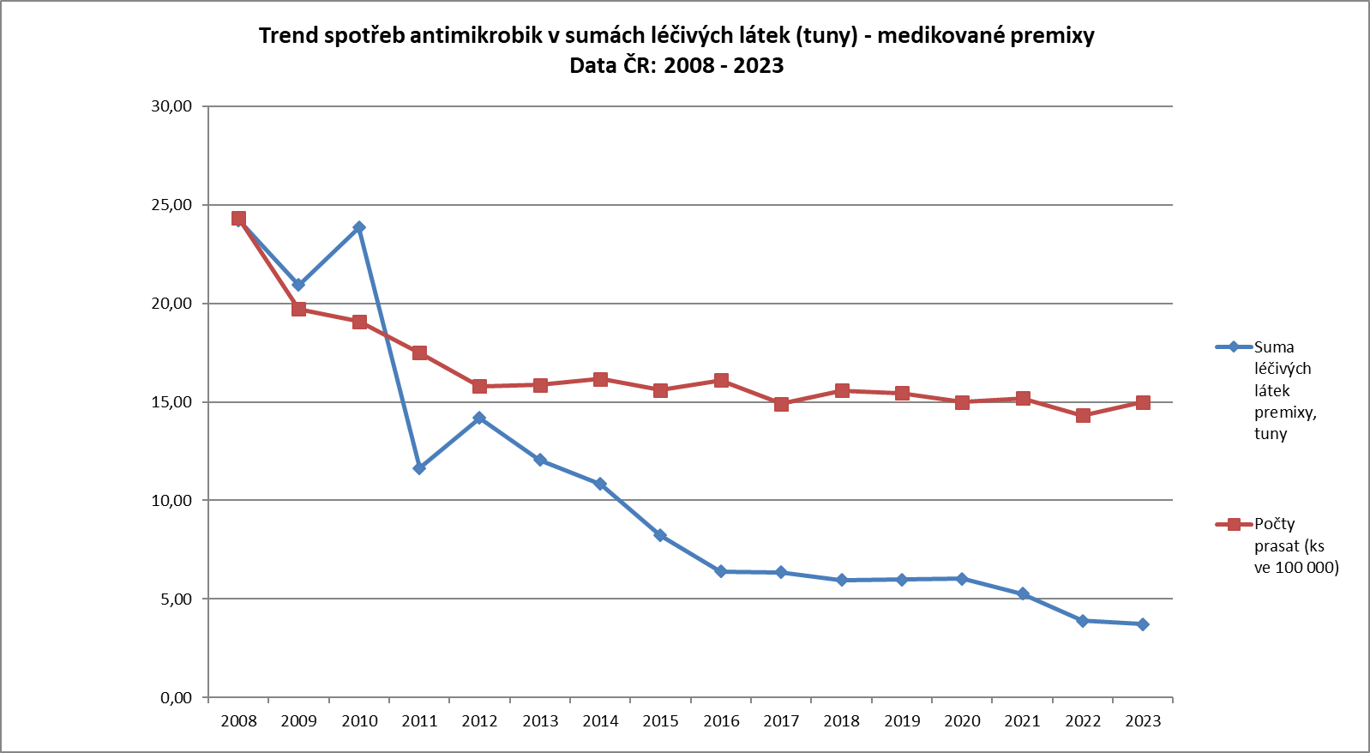
TRENDS in anticrobials consumption – targeted on MEDICATED FEED
98 % of antimicrobials used in the form of MF administered to pigs
Approx 2% rabbits, poultry, other minor species
Continuing decrease of use of medicated feed containing antimicrobials (- 85% in 2008 – 2023)
Individualisation of administration increase (injectable pharmaceutical forms) or targeted administration to the smaller groups of animals and to this linked administration of the pharmaceutical forms via drinking water medication
Pig population
decrease 2008 – 2023: - 41%
Consumption of antimicrobials
in MF – trend
Decrease 2008 – 2023: - 85%

Slide 18
Thank you

