Slide 1
Case study: herd health care, management and use of antimicrobials in two dairy cattle farms
MVDr. Petra Šinová
Brno, 22. 11. 2024
Hands-on training for farmers and veterinarians – CZ
CASE STUDY
Notes:
1

Slide 2
Introduction
I have been working as a veterinarian for 14 years in general practice
Most of my patients are dairy cows
also run a small practice for companion animal
work with one younger colleague
I have been a member of board of the Chamber of Veterinary Surgeons for 5 years, including 3 years as President
Notes:
2

Slide 3
Life is about the need to percept colocations
Milk production is increasing BUT the number of cows is decreasing
2013
Productivity has 7 443 litres per cow/year
2024 CZ (1st half):
Productivity has exceeded 9 500 litres per cow/year
Average daily production of milk per cow in CZ= 26, 64 L
2023 prices CZ
The farm gate milk price has exceeded 0,4 euro/litre in 2023 (for the first time since 2008)
In January 2024, the farm buyout milk price was over 0,52 euro, the highest price in 33 years.
The average price of milk in shops is 0.8 euro
Breeds DAIRY:
60,4% Holstein cattle,
34,9 % Bohemian spotted cattle
4,7 % the other breed
COSTS
associated with production:
energy, fuel + barns (re)constructions
HUMAN resources:
Farmers struggle with shortage of workers
The old farmers have been leaving and the young one have lost their relationship with the land and cattle

Slide 4
Veterinary care in livestock farms
We can´t talk about standard situation in dairy cattle breeding in Czech Republic
Enterprises have different levels:
renovated old barns/new air barns,
old types of milking parlours/robotic milking,
shrewed zootechnical technician/digital systems monitoring activity, rumination or estrus,
obsolete calf breeding methods/air calf stables)
Industrial livestock farming/family farms
Closed herd turnovers/animal purchases
Cooperating zootechnician/zootechnician not accepting changes
Enterprises willing to invest in development/Stagnant enterprises

Slide 5
Disease situation, residue checks, documentation
Brucellosis, leukosis or tuberculosis free - Czech Republic
Regular checks for residues in urine (targeted on banned substances)
Regular monitorings (residues meat and offals)
Milk residues (screening tests ... confirmatory tests – offic labs)
Official veterinarians carry out wellfare checks
Production is also checked regularly
Documentation Vets/ Farmers checkup are carried out
Farmers – Information on Food Chain (form filled/treatment statement/ in animal/s for slaughter)
Notes:
5

Slide 6
Overall use of antibiotics in food producing animals
Data source:

Slide 7
CASE STUDIES
I) Big farm: 300 dairy cows
II) Small farm: 60 dairy cows

Slide 8
CASE STUDY 1: Farm of 300 dairy cows - 4 years ago
High incidence of mastitis, especially in calved cows
High amount of somatic cells in milk
Very frequent occurrence of Str. Uberis
Occurrence of resistant strains of bacteria
High incidence of mortality
High incidence of lameness
Reproductive performance good in dairy cows, worse in heifers
Frequent occurrence of metritis, left-sided splenic dislocations, etc.
Notes:
8

Slide 9
Farm of 300 dairy cows – Beginning - I
A full veterinary service was carried out at the beginning,
Checking:
milking hygiene
intramammary administration
dry period preparation.
Checking the results of the productivity control, including the level of somatic cells.
Microbiological analysis of the milk, including determination of the causative agent,
Introduction of mastitis register (unfortunately written form),
Introduction of „ON-farm cultivation“
Regular inspection of feed ingredients, mixtures and bedding material
Notes:
9

Slide 10
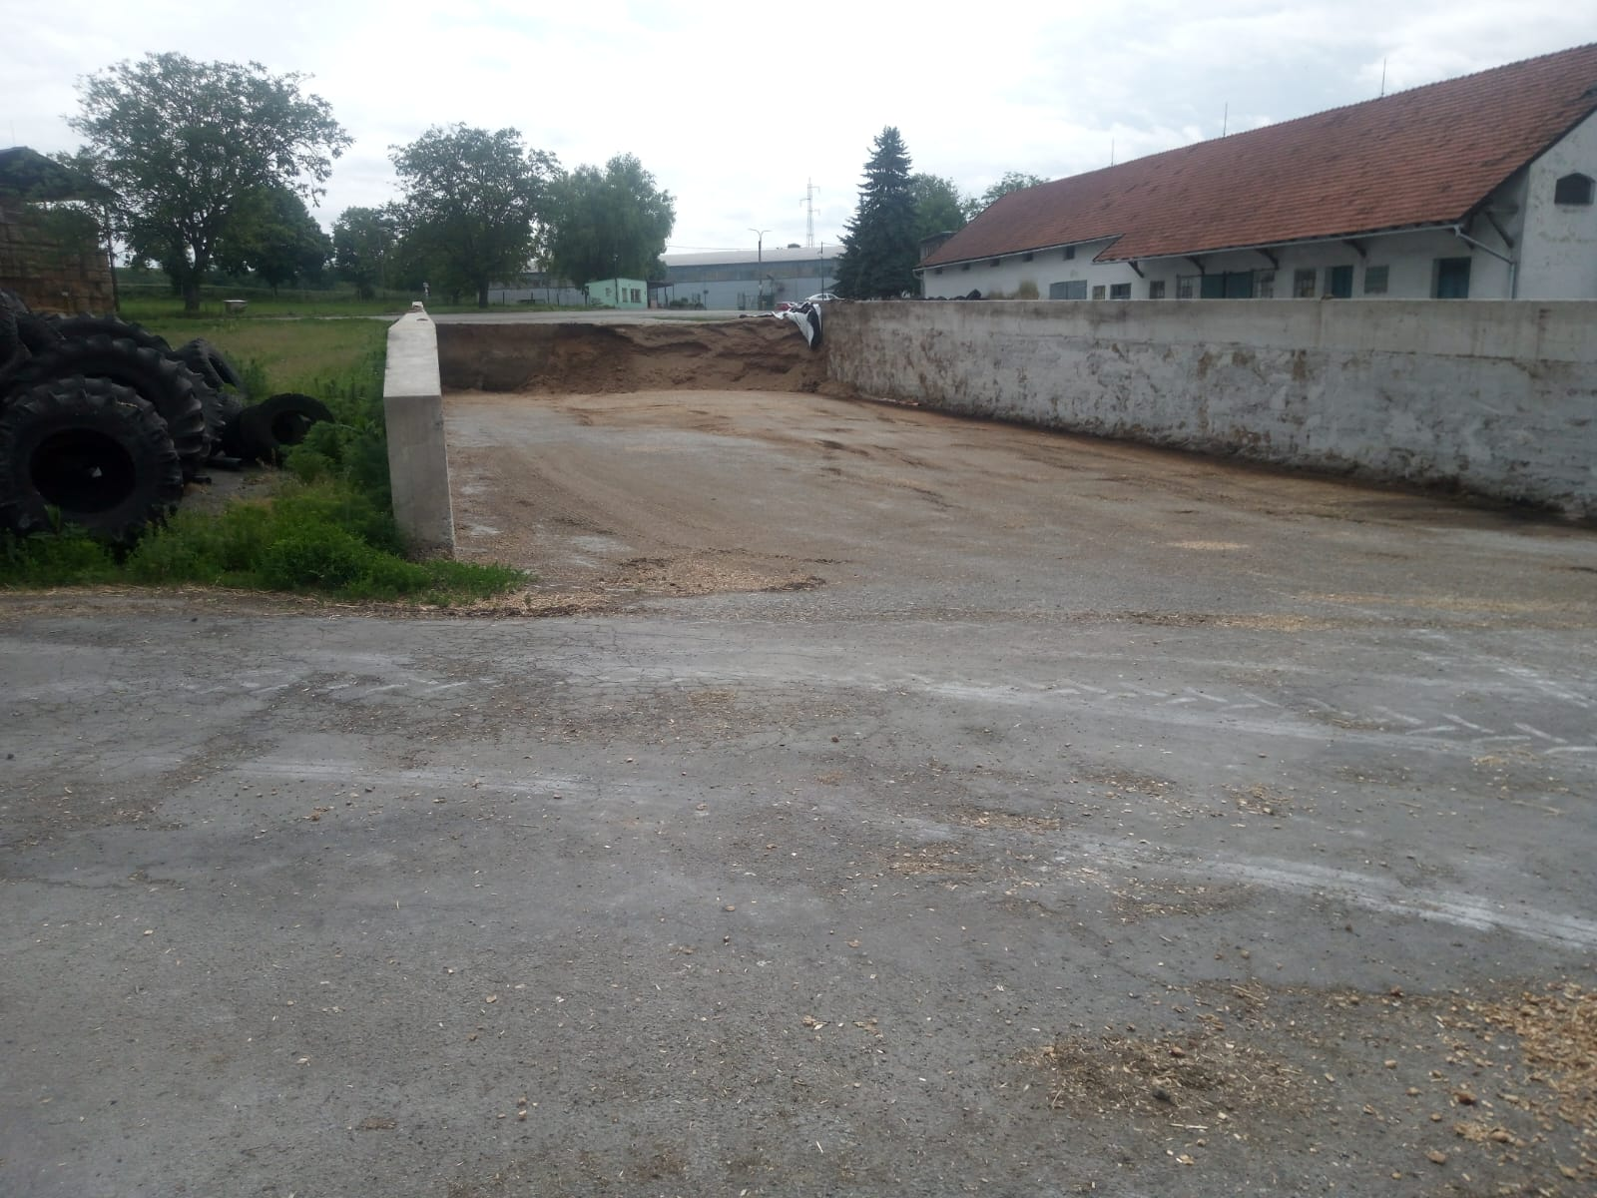
Farm of 300 dairy cows – Beginning - II
Control of post-natal care of the dairy cow and calf
Condition of birthing cords and their disinfection
Hygiene of birth and postpartum management
Treatment of the navel and feeding of the calf
Management and using of colostrum
Zoohygiene of drinking containers and storage of milk mixtures, milktaxi
Dehorning
Bedding
Stable tests for the detection of enteritis agents
Notes:
10

Slide 11
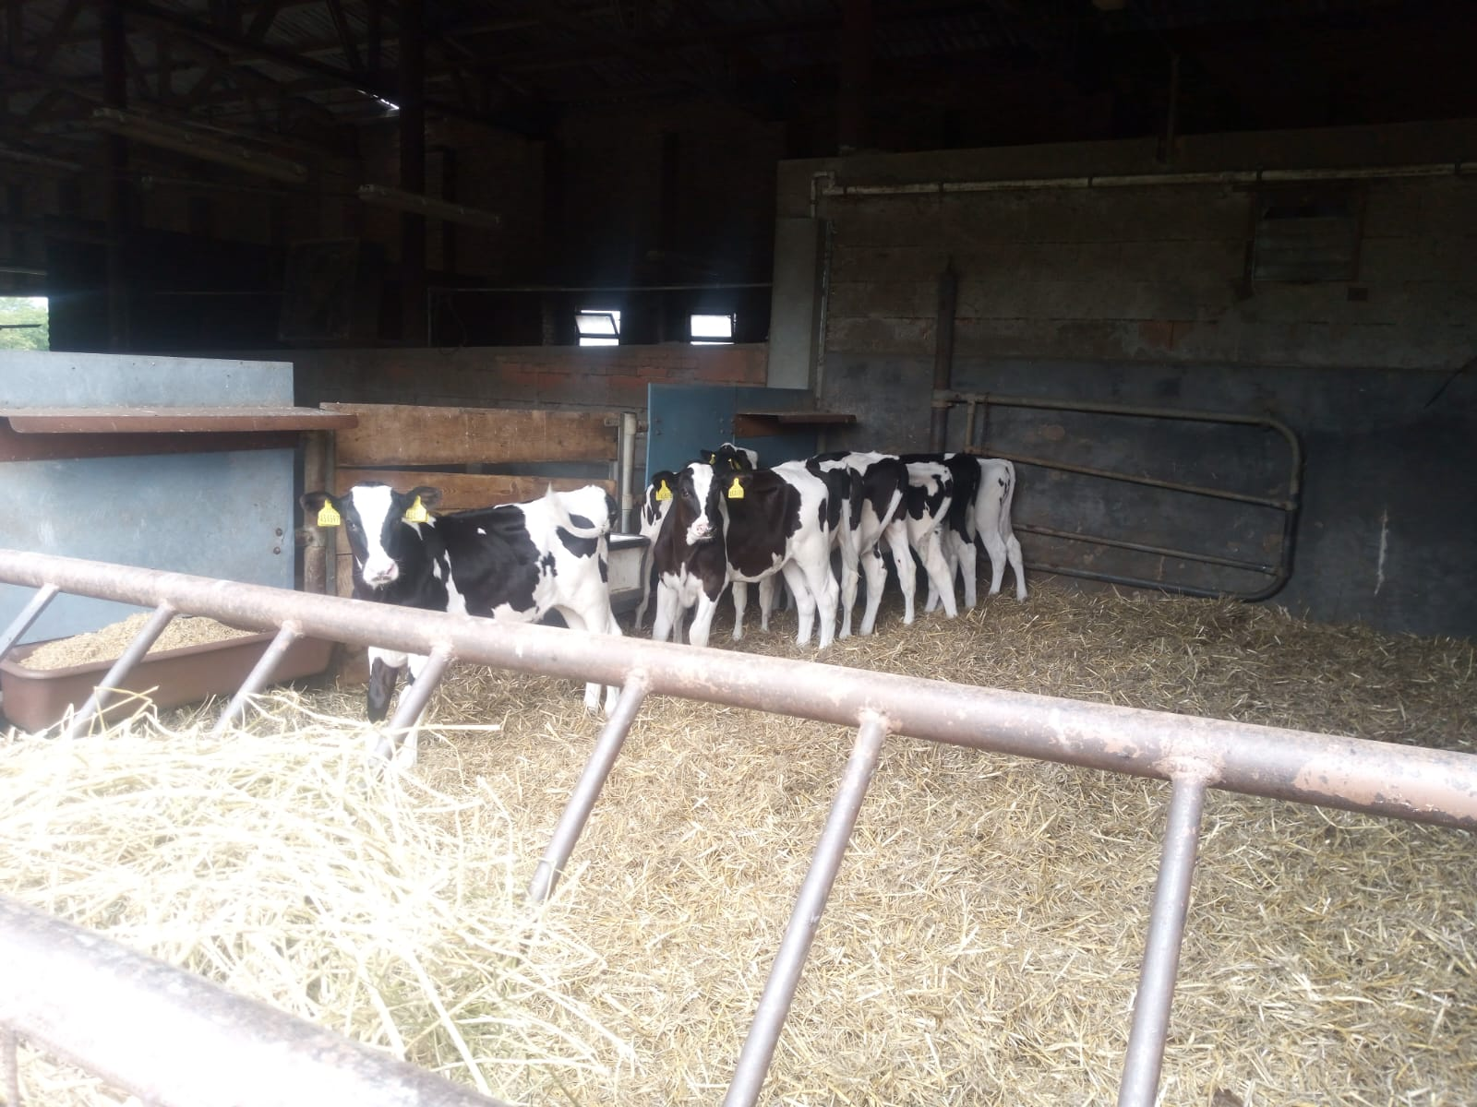
Farm of 300 dairy cows – Beginning - III
Introduction of a register of lame cows
Checking the propriety of hoof lavage
Hoof treatment at regular intervals + immediate treatment of acute lameness
Continual checking of milk yield in lameness animals
Regular checks on animals after birth
Determination of blood ketone bodies
Gynaecological checks
Measurement of body temperature
Monitoring of the milk yield
Notes:
11

Slide 12
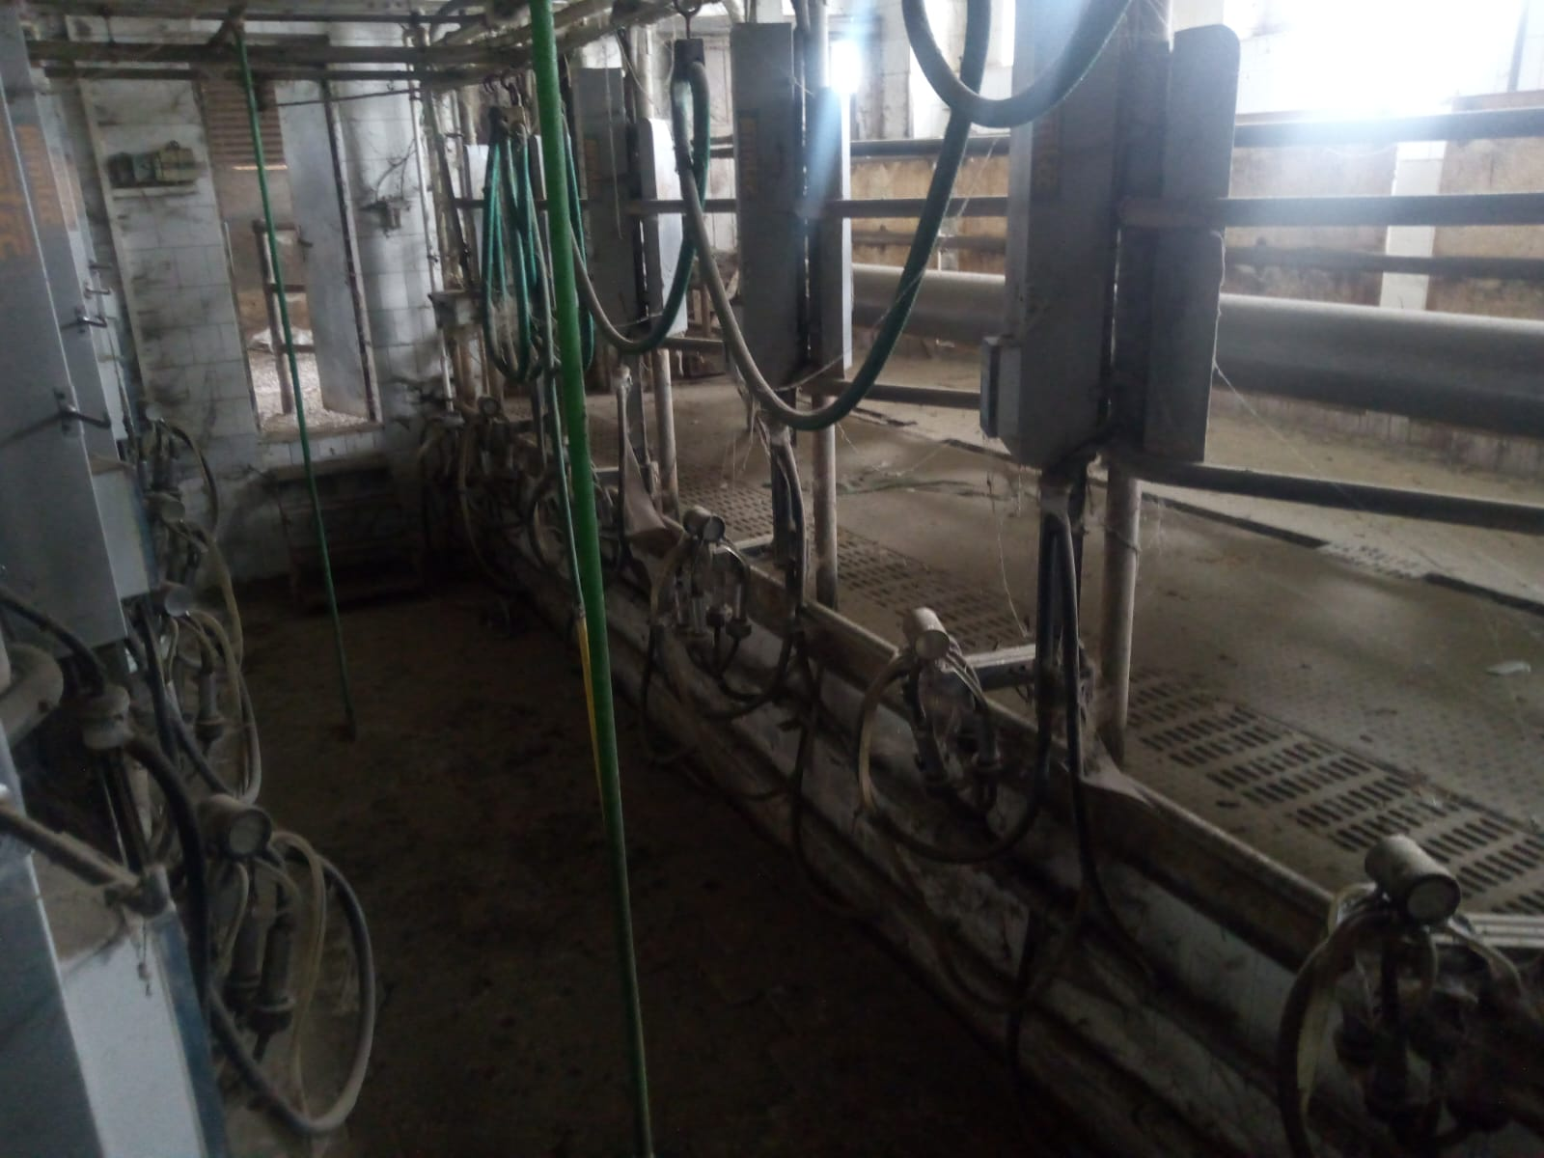
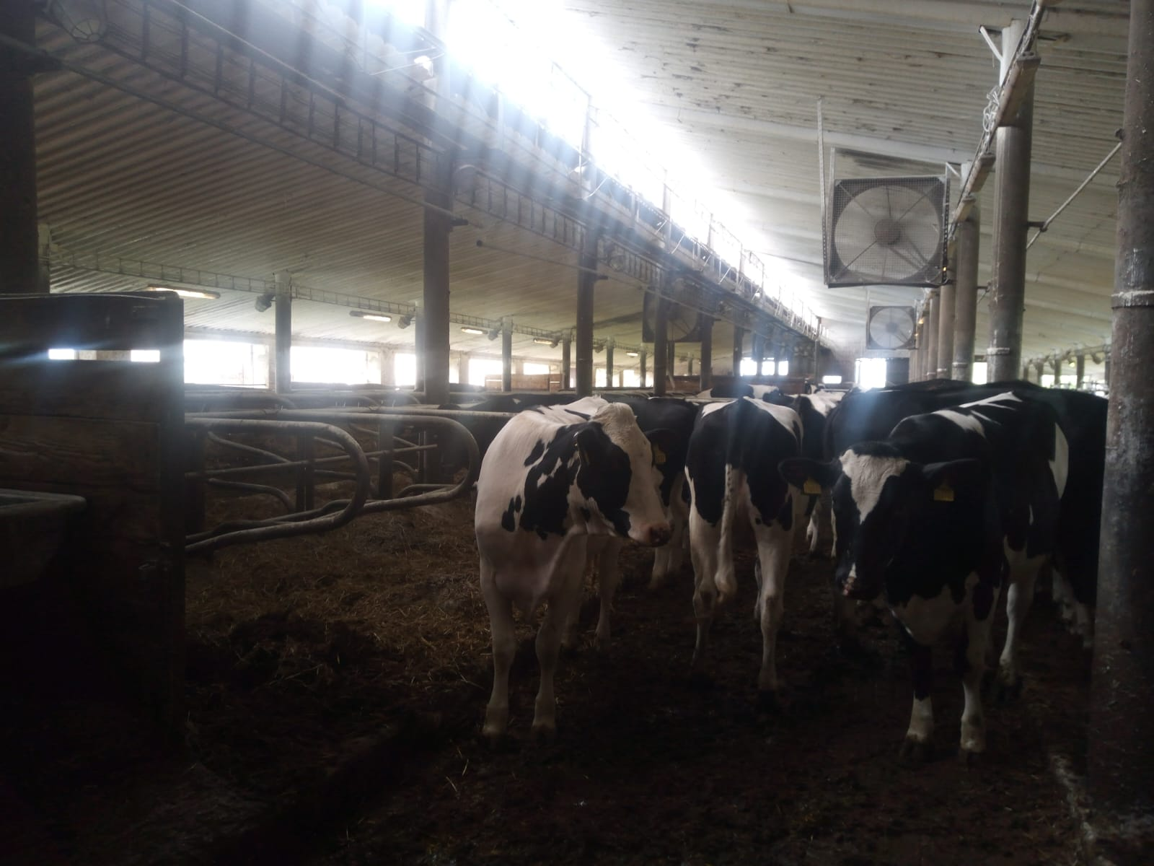
CASE STUDY I - FARM initial stage
Notes:
12

Slide 13
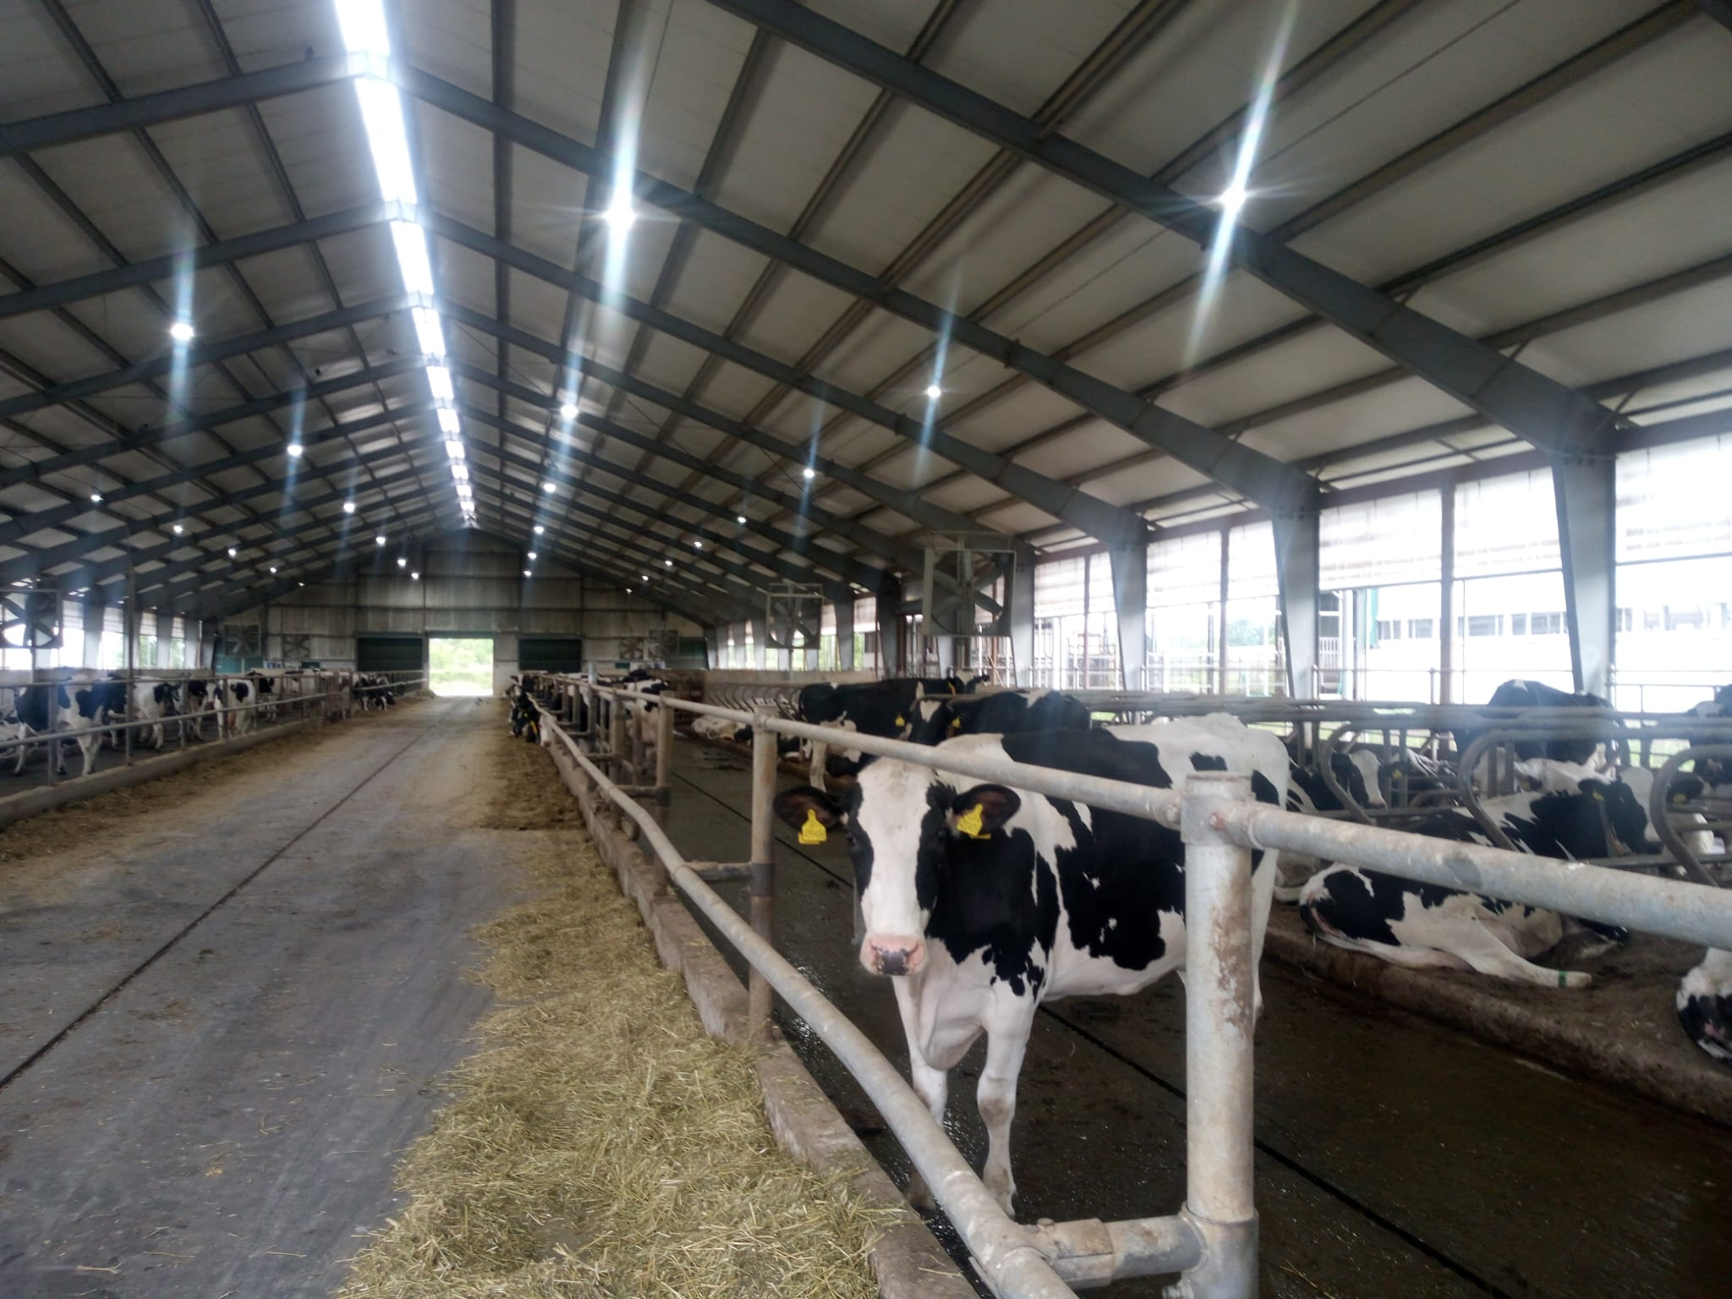
Technological changes on the farm
Moving the animals to a new stable
Positives
Pedometers
Regular removal of excrement
Ventilators
High ceilings
Negatives
Bedding is separate
Fixation cage for hoof treatment missing
Relatively narrow chasing walkways to the milking parlour
Notes:
13

Slide 14
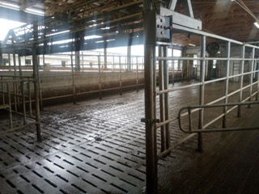
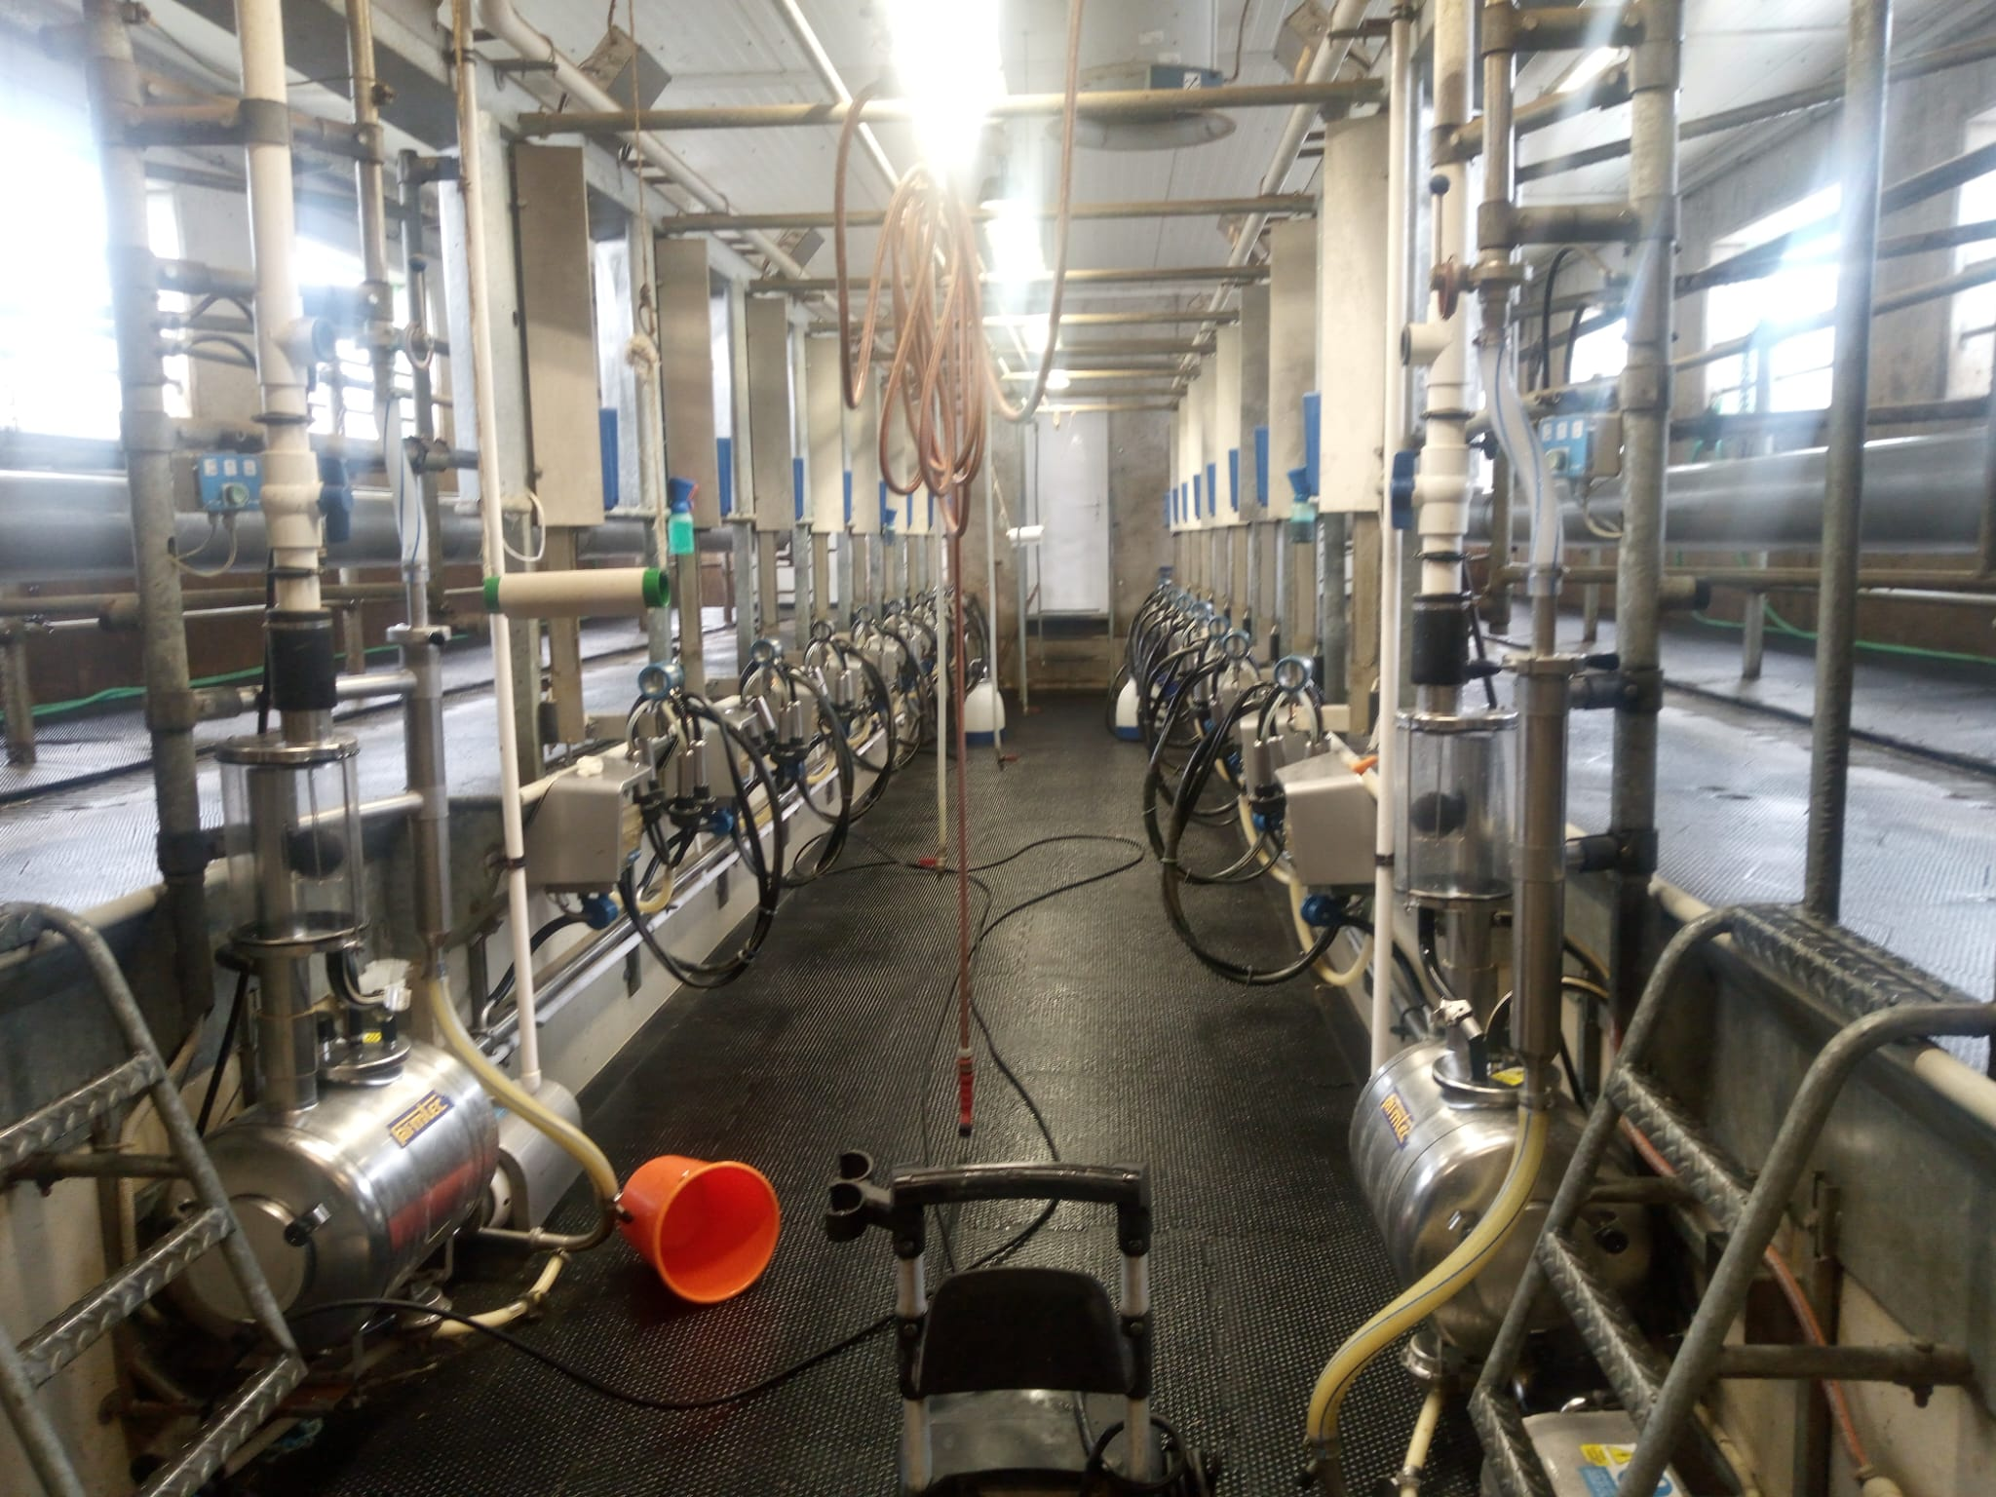
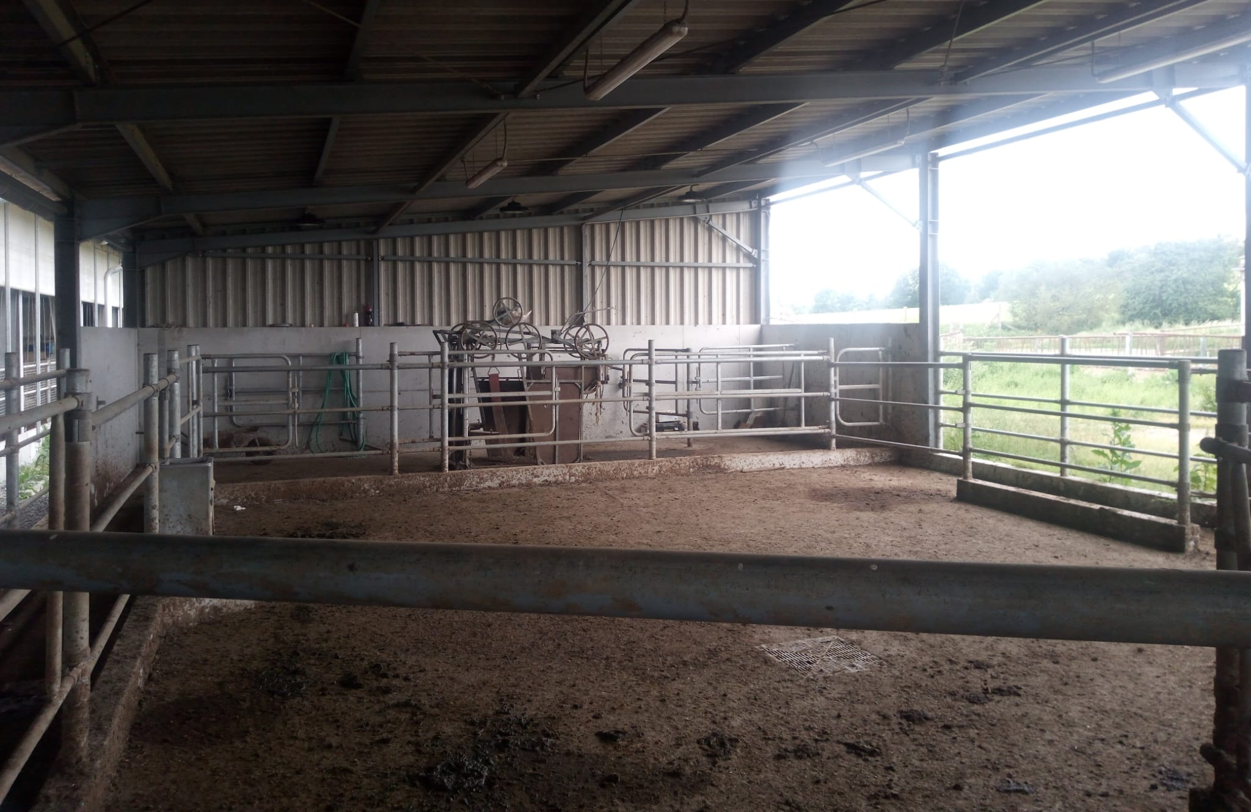
CASE STUDY I - FARM new technologies and barn

Slide 15
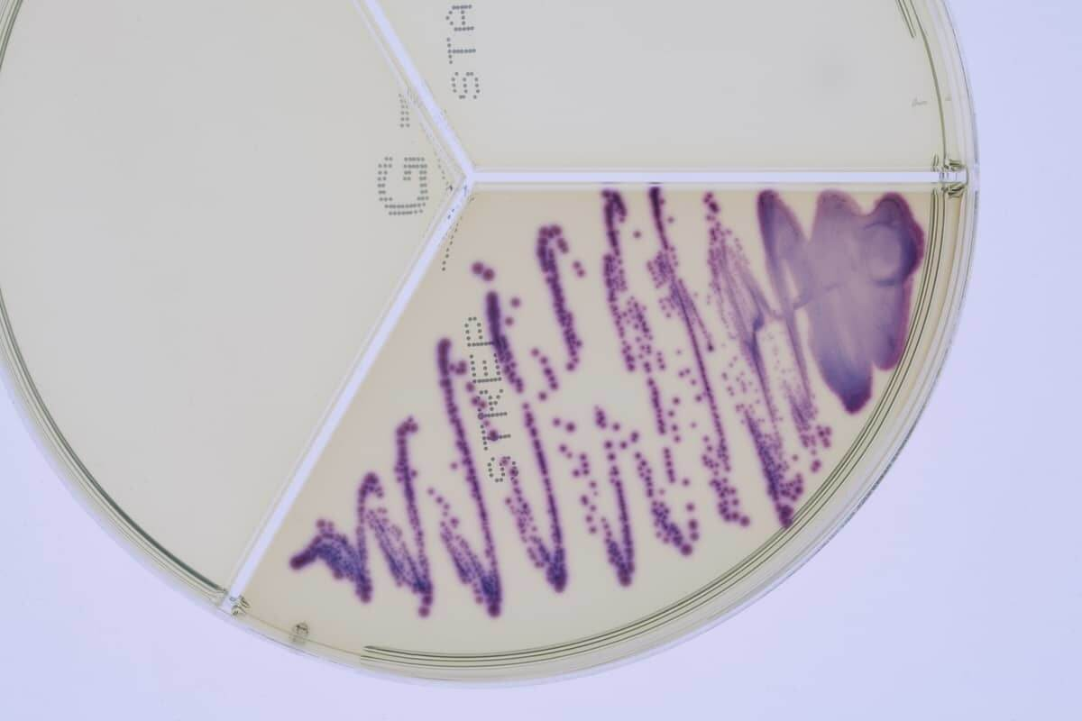
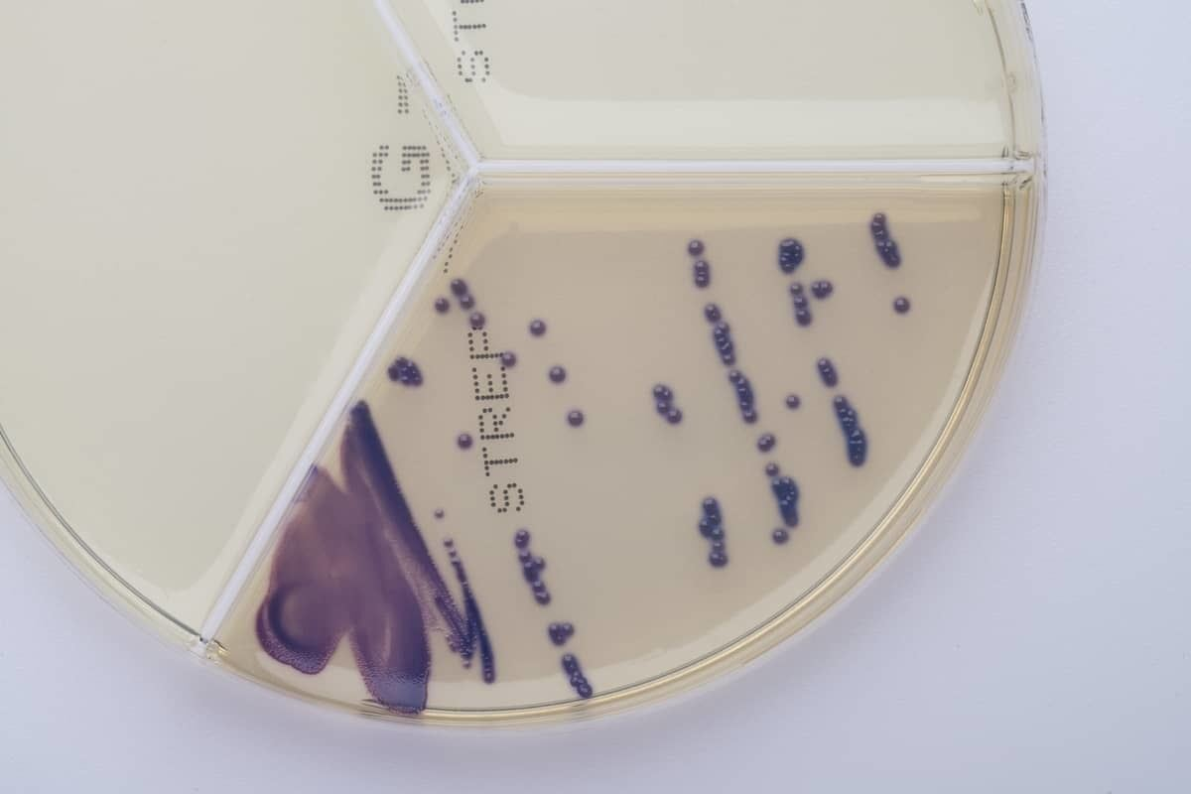
Prevention of the occurrence and spread of Streptococcus uberis
Phased culling of old dairy cows with high somatic cell counts and dairy cows with recurrent Streptococcus uberis
Introduction of treatment programmes according to susceptibility and checking susceptibility twice a year
Introduction of selective care before dry period
Vaccination was only agreed by the breeder after two years and his arguments were
High cost
Unsure result
Nobody in the area does it
Notes:
15

Slide 16
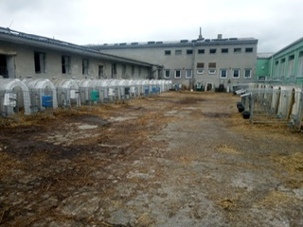
The current issues we are faced with
Diarrhoea after weaning
Not proper zoohygiene in the barn
Coccidia - cryptosporidia
Calves lose fluids - dehydration + hot weather acute conditions
Without improved zoohygiene – the only toll remain is treatment
High infectious pressure - sick animals - not only direct losses ...
A sick calf will never be a good cow - future yield losses
Calves don't make a profit so hardly anyone invests in them
Notes:
16

Slide 17
The costs of treating animals are identical !
Notes:
17

Slide 18
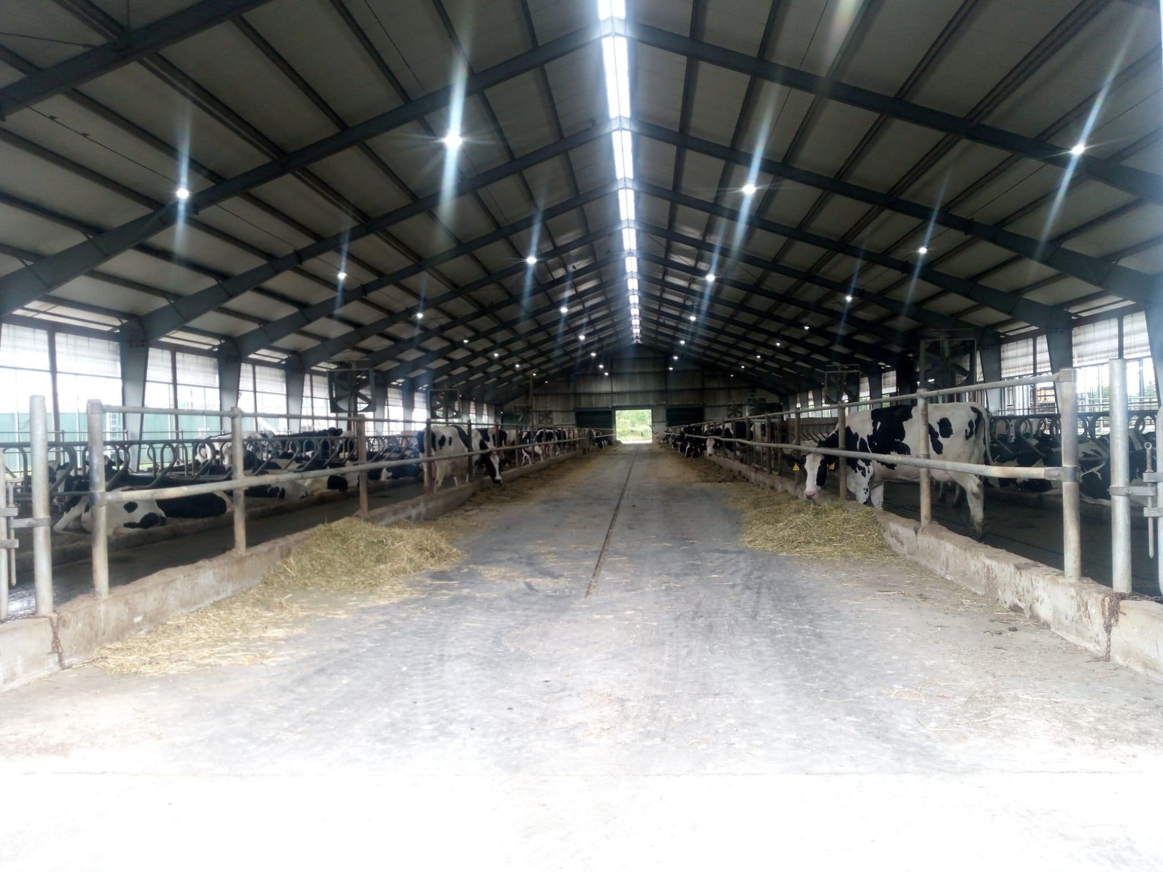
Results of our work together
reduction of somatic cell counts
a moderate increase in the amount of milk per cow
less milk to be discarded
more milk sold
lower numbers of animals culled
Notes:
18

Slide 19
CASE STUDY 2: Family farm with 60 dairy cows
Ten years in operation, owner is 38 years old woman
Initially, it was an effort to save dairy cows from a breeding farm that had been shut down
A provisional barn was created from an old hayloft
Purpose of the farm: to be open to the public - educating children
Has a mini-dairy production: milk, cream, yogurt, cheese, etc.
Currently delivery of products to local supermarkets
There is a café and shop on the spot, selling own products and products from other local producers
Notes:
19

Slide 20
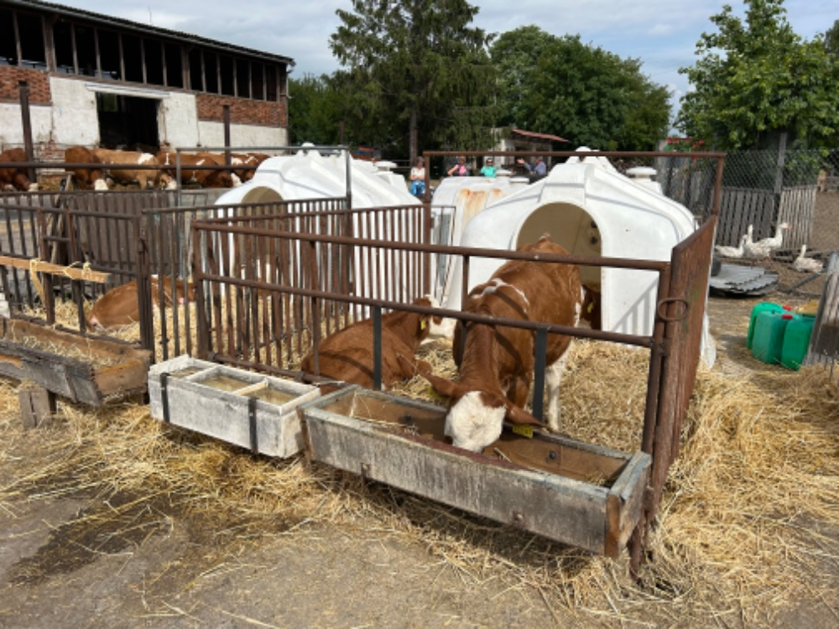
Initial issues
Robotic milking
teach animals to the new milking system
Culling cows with asymmetric udders
Develop disinfection protocol + appropriate disinfection of the robot's teat cleaning brushes
Learn to detect technical problems of the robot quickly
Deal with inadequate post dip
Dairy cows are still kept on deep bedding (straw) without beds
Heifers and dry cows are mostly in outdoor paddocks
There is still a missing roof over the feedlot
Notes:
20

Slide 21
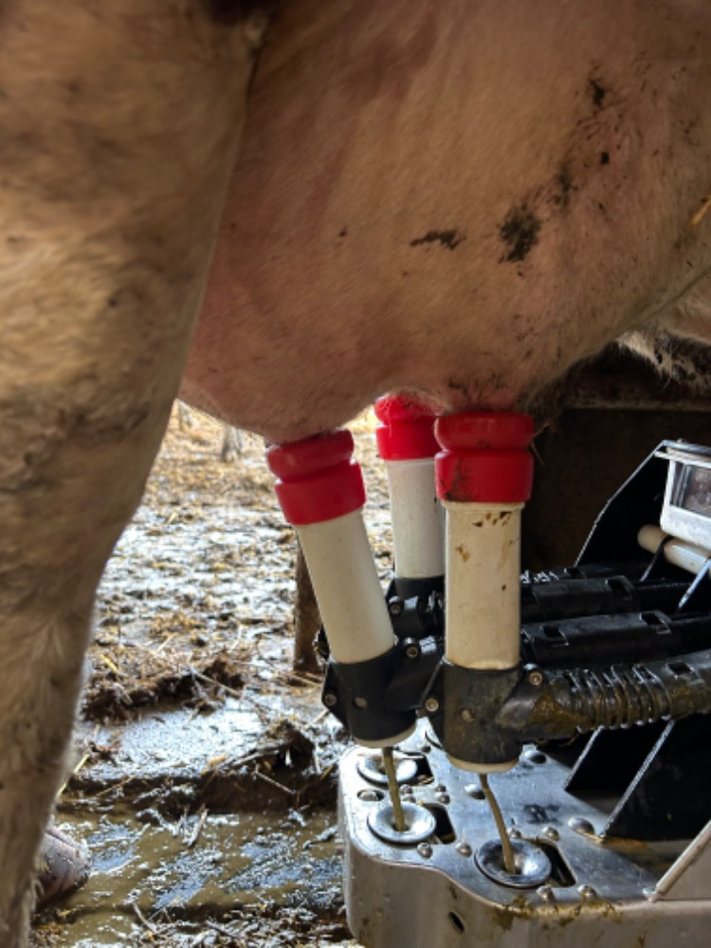
Notes:
21

Slide 22
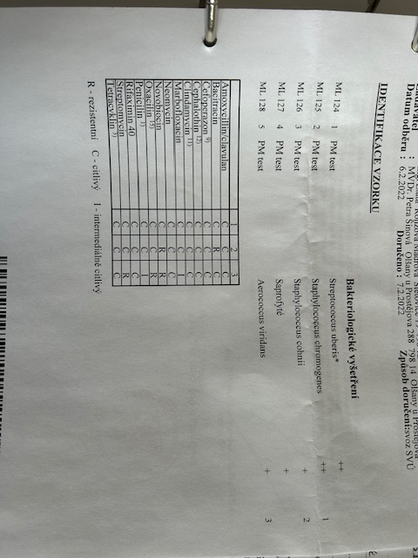
Herd health status and prevention
Because there is no budget for technological changes, we had to introduce an intensive prophylactic program (commercial vaccines) and zoohygiene at the level, which has been possible
We currently vaccinating
Streptococcus uberis
Staphylococcus aureus and G- (protection against mastitis)
Rotaviruses, E. coli (protection of calves against diarrhea)
Clostridia (protection of all categories)
PI, BRSV, Pasteurella (calves)
Disease occurs sporadically, mostly in the form of injuries often on the teat
Reproduction is on excellent level
Notes:
22

Slide 23
Educational activities for the public
On the farm, the public has access not only directly to the animals, but also to milking robot
Attendance is huge, including excursions of nurseries and schools
Visitors send a large number of complaints to State Veterinary Administration for investigation, which is a big problem :
The cows are dirty - it has been raining for two weeks straight so everything is dirty
The cows are spray painted on their heads - yes it's really not graffiti
Calves are stolen from their mothers and put in separate pens - the mothers suffer
… etc.
The farmer is under constant pressure from the authorities to close the farm to the public to avoid having dealing with complaints
Notes:
23

Slide 24
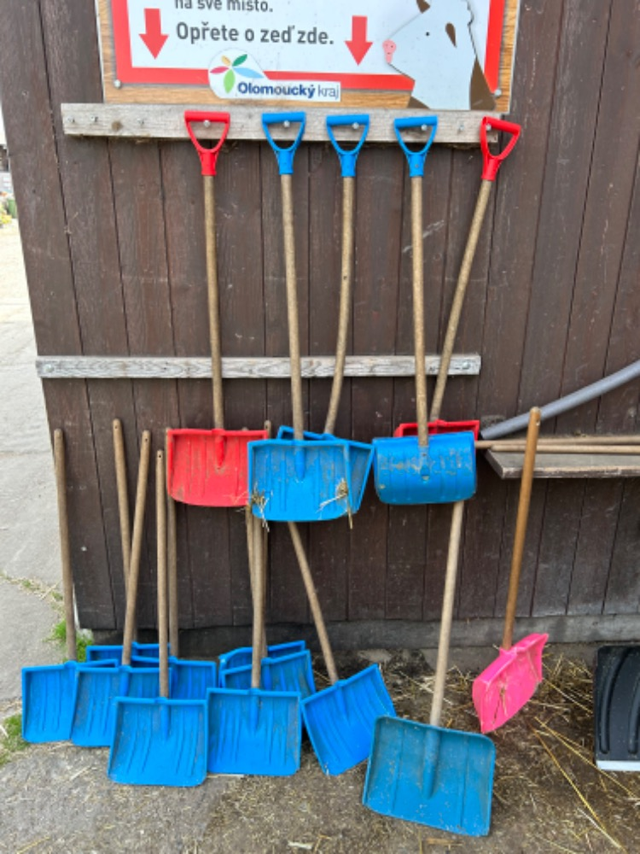
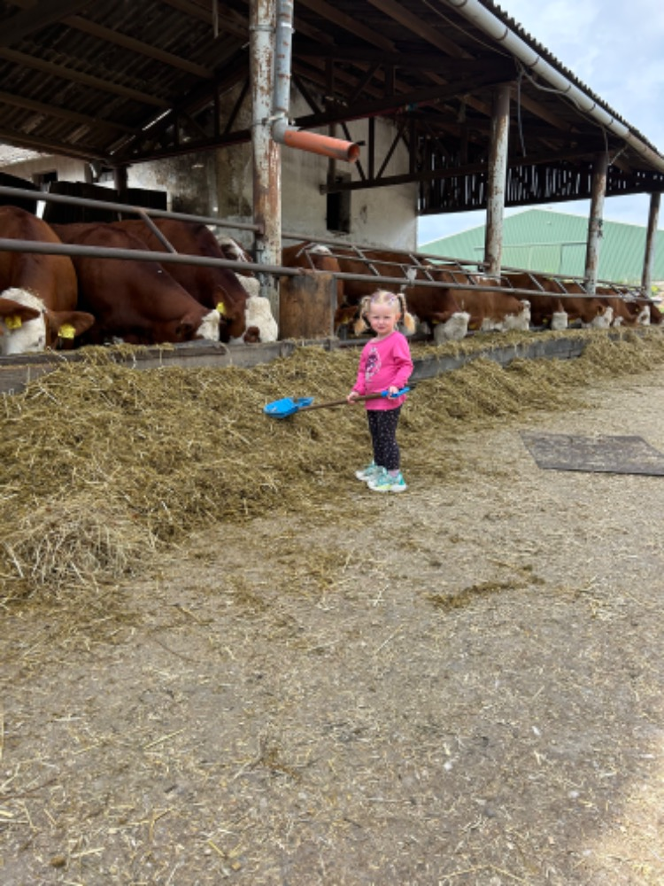
Notes:
24

Slide 25
The costs of treating animals are identical !
Notes:
25

Slide 26
If the breeder want and cooperate with the veterinarian, everything is easier and possible!

Slide 27
Thanks for your attention!
Notes:
27

