Slide 1
Measures to control infections in pigs as a way to farming with minimised use of antibiotics
MVDr. Marek Žižlavský, Ph.D.
Brno, 22. 11. 2024
Hands-on training for farmers and veterinarians – CZ
CASE STUDY

Slide 2
Outline of the presentation
Eradication of very dangerous infectious diseases
2. Evolution of the disease situation between 1989 and 2024
- Repopulations of pig farms into SPF health status
Plan for further reduction of antimicrobial consumption
period 2023-2027 (2030)
Measures to increase immunity in pig farming by vaccination
Subsidies to promote vaccination

Slide 3
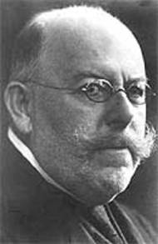
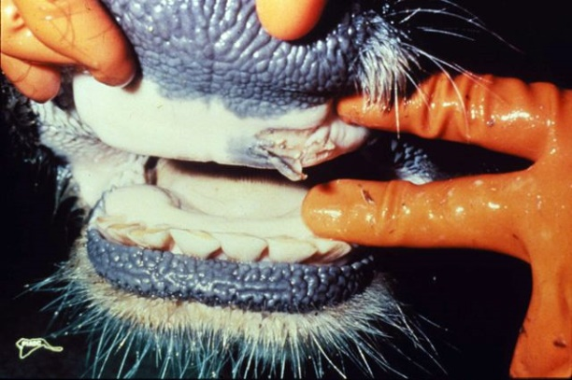
Foot-and-mouth disease
1897 Friedrich Loeffler and Paul Frosch
First virus causing animal disease (1892 - tobacco mosaic virus)
Afticization, 1871 enacted in Prussia
European pandemics in 1937-39, 1951-52
Vaccination in European countries since1950s
Last occurrence in the Czech Republic in 1975
1.1.1990 vaccination ban
2001 England, 4 million head, €360 million, 2060 outbreaks, illegal importation of meat, feeding pigs with kitchen waste
2011 Bulgaria, wild boar
Illegal trade, laboratory escape (Russia 1993, England 2007)
Risk countries: Turkey, Russia, North Africa
Prof. Kouba, 1964, eradication of SLAK in Mongolia, CS vaccine A+O
Friedrich Loeffler

Slide 4
Aujeszky disease
World-wide spread disease
In Europe, despite considerable efforts, elimination has not been achieved
In the Czech Republic "stamping out" or vaccination methods
In the Czech Republic, the eradication programme ended in 1987 and in 1988 the Czech Republic was recognised by the OIE as an AD-free country
Czech Republic's EU status confirmed in 2004
In 2003 outbreak in domestic pigs
However, the wild pig is also a host and reservoir in the Czech Republic
Seropositivity studies in wild boar in 2017: 21.4% (82,114 samples, of which 17,572 positive)
Risk for hunting dogs (in dogs the disease mimics rabies infection)
Risk for pig farms

Slide 5
Classical swine fever
Since 1975, the virus has not been in the population of wild boars
Imported from Austria in October 1990
Vaccination in domestic pig farms
Ban of vaccination in the Czech Republic as of 1 July 1992
The National Reference Laboratory (NRL) Jihlava - established (1991-92)
Last detection of the virus in wild boars 1999 (Vsetín)
Last virus detection in domestic pigs 1997 (Kroměříž)

Slide 6
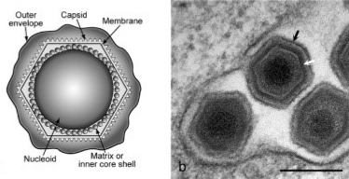
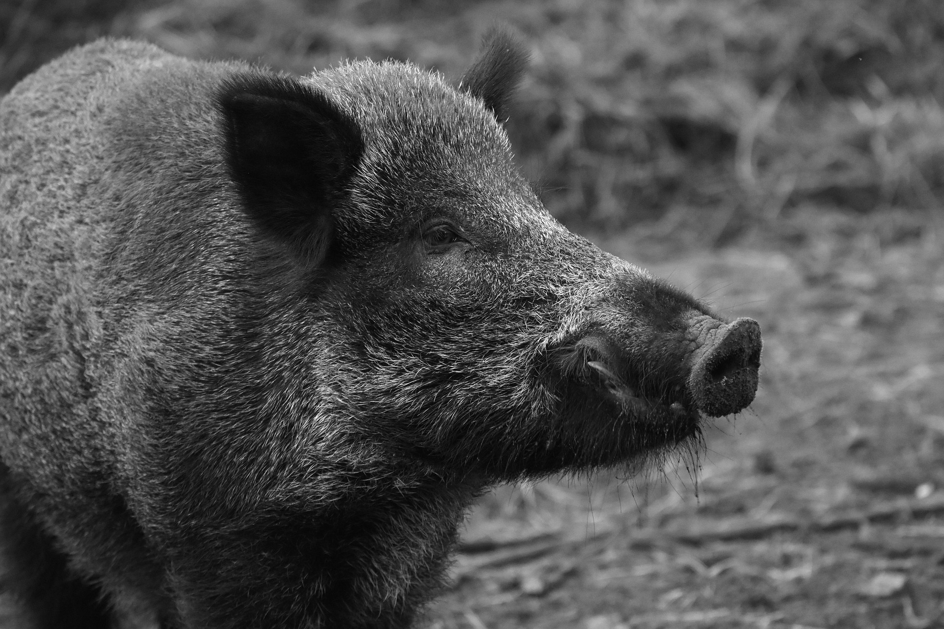
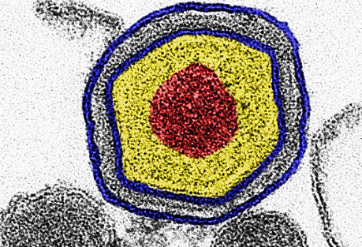
African swine fever
Coated DNA virus family Asfariviridae, genus Asfivirus.
African swine fever in the Czech Republic is only in wild boars and is still endemic in the area of CZ
First occurrence in wild pigs - 26.6.2017 NRL for ASF (SVÚ Jihlava) confirmed the occurrence of ASF in the Czech Republic in a wild boar (Zelechovice nad Dřevnicí, Zlín)
2019-2022 Czech Republic free of ASF
Second occurrence in wild boar in 2022 - total of 84 positive cases
Situation 2024 yet 27 positive cases

Slide 7
Evolution of the disease situation CZ
Eradication of very dangerous infectious diseases
Period 1989-2008-2010-2018-2023
- significant deterioration in the health status of pig holdings
- huge consumption of antibiotics - veterinary care 0,16-0,24 €/kg body live weight
- since 2008 repopulation of pig farms to SPF status
- 2010 first subsidies for pigs 8.F.a. and 8.F.b.(d)
- repopulation led to drop in consumption of antimicrobials at the level of 42,2 mg/PCU (2023)
- after repopulations, the cost of veterinary care is 0,024-0,048 €/kg body live weight
3 . Plan of further decrease in consumption of antimicrobials: period 2023-2027 (2030)
- measures to increase immunity in pigs by vaccination
- the aim is to gradually reduce the consumption of antimicrobials below 50 mg/CPU

Slide 8
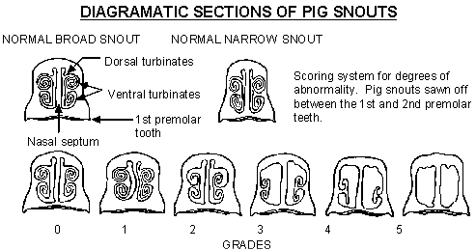
Development of the disease situation in pig farms in the Czech Republic
In the post-1989 period, the disease situation in stables has gradually worsened
Atrophic rhinitis, Enzootic pneumonia, Porcine pleuropneumonia, Swine Dysentery, PRRS, PCV2, lice, scabies
Import of breeding material
Movements of animals without knowledge of the disease situation
Loading piglets from several farms for fattening
Non-compliance with biosecurity rules
The Czech Republic has become a sick and uncompetitive country
Since 2004, the Health Programme of the Pig Breeders' Association (HP PBA) has been applied to nucleus breeds, Breeding and Multiplication farms and AI stations
ISOWEAN - MMEW, MEW, SEW, Multi-site, Two-site, Three-site

Slide 9
Development in disease situation in pig sector in CZ
In 2008, repopulations to SPF status began
Functional biosecurity reestablished and implemented
Low density of pig farms
Minimum reinfections to date
Only aerogenic infections (Mycoplasma hyopneumoniae)
Today more than 85% of holdings in SPF status
The Czech Republic is one of the healthiest countries today
Zootechnical results 35-40 weaned piglets per sow per year
More than 1000g daily weight gain in fattening at conversion below 2.5 kg/kg

Slide 10
Trend in number of sows
in the Czech Republic 1992 – 2023
Joining EU (2004), start of steep decline in sow numbers => gradual loss of self-sufficiency pork meat production
Start of repopulation (approx. 2010), first subsidies, followed by a period of very slow drop down
Source: Czech Statistical Office, December 2023
www.sevaron.cz

Slide 11
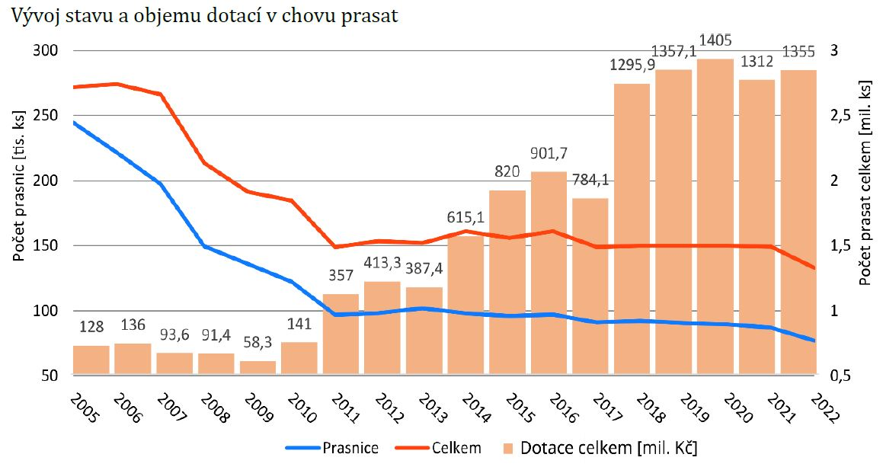
Trend in number of animals and subsidies in pig sector
2005 - 2022
Zdroj: SCHP

Slide 12
Trends in overal consumption of veterinary antimicrobials CZ 2008 – 2022, population correction unit used
CZ 2018 – 2022: Farm to Fork decrease by 18,6% (mg/PCU)
2018: ČR celkově 57 mg/PCU = medián evropy 57 mg/PCU, výrazně pod průměr 103,2 mg/PCU pro 31 států EU/EEA)

Slide 13
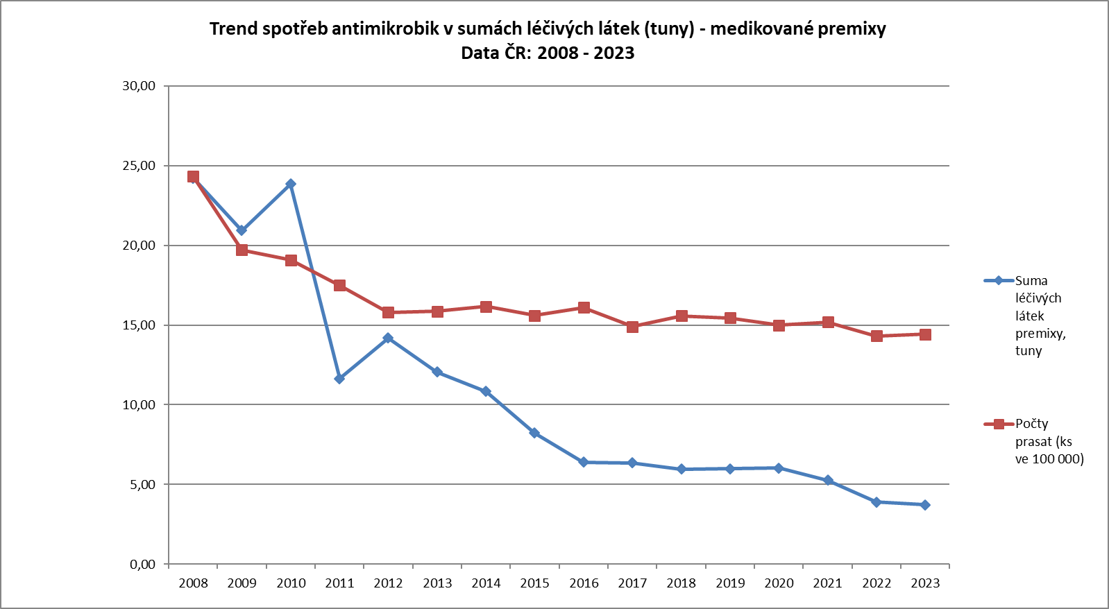
Trends antimicrobials as a sum of the active substances in premix CZ 2008 - 2023
Pig population decrease by 41%
Consumption of antimicrobials decrease by 85%

Slide 14
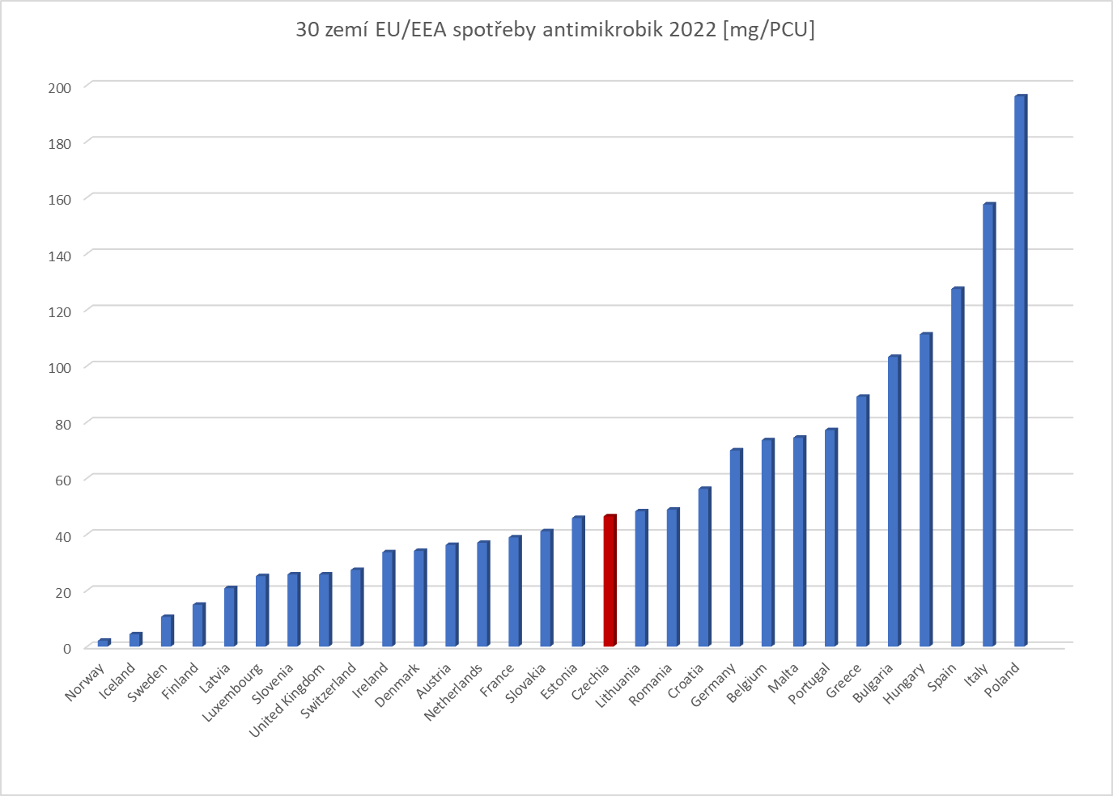
Position of CZ (2022) and the other Member States of EU/EEA Data o sales of vet ATM corrected towards population of food producing animals [mg/PCU]
Position of CZ comparing to other EU/EEA and what is needed to improve?
Total consumption slightly above median, decrease continuing
CONTINUE need to be targeted also on qualitative improvement
CZ (46,4 mg/PCU) je
Slightly above EU median EU (45,8 mg/PCU): 16 MSs < CZ < 14 MSs
Significantly below EU mean (73,9 mg/PCU)
Pozn. Z důvodu poměrového zobrazení detailů graf neobsahuje Kypr: 254,7 mg/PCU
Data should be interpreted with great caution, animal population demography difers among individual countries as well as portfolio of antimicrobials used, more details explained on spot
Data source ESVAC: Sales of veterinary antimicrobial agents in 31EU/EEA countries in 2022 – European Surveillance of Veterinary Antimicrobial Consumption (ESVAC) | European Medicines Agency (europa.eu)
Notes:
Data o prodejích veterinárních antimikrobik za rok 2016 ve 30 státech EU/EEA (poslední dostupná souhrnná data za oblast EU/EEA publikována 2018, v řadě států důrazná opatření na snížení spotřeb)
Je velký rozptyl dat (nejnižší 2.9 – nejvyšší 453.4 mg/PCU), průměr 124.6 mg/PCU , medián 57.0 mg/PCU. ( ČR 61,2 mg/PCU) – tj. Polovina průměru, lehce nad mediánem, na 16. místě z 30 států
Při porovnání států si musíme být vědomi, že existují parametry, které činí data obtížně srovnatelnými ! Proto srovnání, ač matematicky korektní, je pouze orientační !
- mezi jednotlivými státy se liší rozvrstvení v rámci hospodářských zvířat (např. DK má významný sektor prasat, NL sektor skotu a drůbeže atp.)
- různá intenzita/velikost chovů, technologie chovů a management
různé portfolio dostupných VLP na trhu každého ze států a s tím částečně související rozsah používání
klimatické poměry
socioekonomické faktory
Je rovněž nutno brát v úvahu, že toto jsou OFICIÁLNĚ nahlášená data o prodejích antimikrobik v registrovaných VLP (vybrané státy mají všech – tedy i např. na výjimky povolených) v daných členských státech
Protože ČR (i cca 9 dalších států) má dostupná validní data již přibližně 10 let, je vhodné spíše sledovat trendy vývoje v každém státě individuálně a zaměřit se spíše na určité ukazatele (např. používání antimikrobik kriticky významných z pohledu veřejného zdraví (např. cefalosporiny 3.a a 4. generace a fluorochinolony)

Slide 15
EU BAROMETR
Farm to Fork target
CZ: 2023 - 42.2 mg/PCU

Slide 16
Evolution of the disease situation CZ
Eradication of very dangerous infectious diseases
Period 1989-2008-2010-2018-2023
- significant deterioration in the health status of pig holdings
- huge consumption of antibiotics - veterinary care 0,16-0,24 €/kg body live weight
- since 2008 repopulation of pig farms to SPF status
- 2010 first subsidies for pigs 8.F.a. and 8.F.b.(d)
- repopulation led to drop in consumption of antimicrobials at the level of 42,2 mg/PCU (2023)
- after repopulations, the cost of veterinary care is 0,024-0,048 €/kg body live weight
3 . Plan of further decrease in consumption of antimicrobials: period 2023-2027 (2030)
- measures to increase immunity in pigs by vaccination
- the aim is to gradually reduce the consumption of antimicrobials below 50 mg/CPU

Slide 17
Measures to control infections in pigs
Requirements for new subsidies: new, measurable achievements, rateable and leading to a reduction in the need for antimicrobial use
Measures proposed for subsidies:
1. Ensurance of sufficient collostrum intake
2. Selection boxes in pre-finisher period as a toll for individualised care of weak
or diseased animals
3. Selection boxes in fattening pigs as a toll for individualised care of weak
or diseased animals
4. Subsidy targeted on vaccination programme
- Primary vaccination
- Subsidised vaccination programme
Approved + CAP subsidy achieved

Slide 19
Primary vs CAP subvenced vaccination programme
Primary vaccination programme - not supported
Suckling piglets´ diarrhoea caused by Escherichia coli vaccination of sows and gilts
Parvovirus and swine erysipelas vaccination of sows and gilts
Vaccinations under another subsidy - PRRS in 8.F.a. or 8.F.d.
CAP supported vaccination programme
Vaccinations to other infectious diseases not listed above
Four categories of pigs subject of subsidy
Cooperation between the MinAgri, IAEI, ISCVBM, CPVS, PBA and the European Commission bodies

Slide 20
Measures to control infections in pigs: categories of pigs
Piglet
Piglets from birth till end of pre-finisher stage, max till end of 14th week
Fattening pig
Pig after end of pre-finishing stage (since 15the week) till slaughter
Gilt
Matured female since 5 months till end of first pregnancy
Sow
Matured female, after at least one parturition

Slide 21
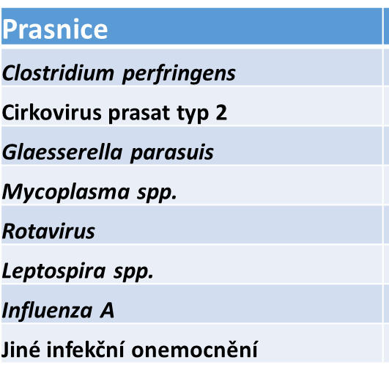
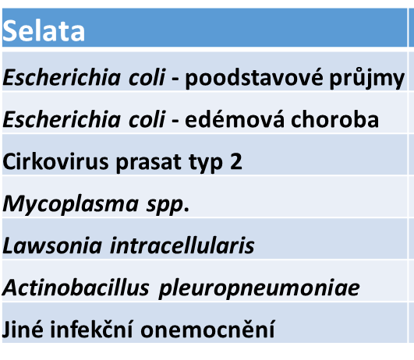
Diseases based on ethiology agens in pigs´categories
GILTS
SOWS
PIGLETS
FATTENING PIG
The subsidy is calculated as the product of
the number of LLUs* of each category and the rates
* LLUs Large Livestock Units

Slide 22
Zootechnical results - Weekly management
Farrowing rate
Born alive
Born alive/gilts
Weak piglets
Stillborn

Slide 23
Zootechnical results - Weekly management
35 slaughter pigs delivered to slaughterhouse/sow/year
Weaned per litter
Lactation days
Regular lactation days
W-I interval
Live borns/sow/year
Weaned/sow/year

Slide 24
Results fattening pigs: 1-3 / 2024
 |  |  | celkem | leden | únor | březen
SELATA | PIGLETS
naskladněno | placement | ks | 37 038 | 12 910 | 10 171 | 13 957
hmotnost | weight | kg | 932 310 | 316 663 | 259 730 | 355 917
průměrná hmotnost | average weight | kg / ks | 25,17 | 24,53 | 25,54 | 25,50
VÝROBA | PRODUCTION
úhyny | death | ks | 986 | 314 | 293 | 379
přírůstek | gain | kg | 3 496 553 | 1 231 786 | 952 744 | 1 312 023
KD | feeding day | KD | 3 355 465 | 1 179 887 | 914 662 | 1 260 916
spotřeba KS | consumption of feed | t | 8 855 | 3 154 | 2 407 | 3 294
úhyny | death | % | 2,66% | 2,43% | 2,88% | 2,72%
NP, nestandardy | NP, nonstandard | % | 1,08% | 1,66% | 0,71% | 0,82%
celkové ztráty | total loss | % | 3,74% | 4,09% | 3,59% | 3,53%
přírůstek | daily weight gain | g / KD | 1 042 | 1 044 | 1 042 | 1 041
spotřeba KS / kg přírůstku | consumption of feed / kg gain | kg / kg | 2,53 | 2,56 | 2,53 | 2,51
spotřeba KS / KD | consumption of feed / day | kg / KD | 2,64 | 2,67 | 2,63 | 2,61

Slide 25
Comparison of conventional and SPF farms in CZ
Parametr | Conventional | SPF
Born all | 12,5 | 19-20
Born alive | 11,1 | 17-18
Weaned per litter | 10 | 14,5-16
Weaned per sow/year | Ø 20,8 | Ø 33,3 (35-40)
Slaughter per sow/year | 18 | 31-35
DWG (25-115kg b.l.w.) | 670-780g | 1000-1150g
FC (25-115kg b.l.w.) | 3,1-3,5 kg/kg | 2,3-2,5 kg/kg
Mortality (7-25kg b.l.w.) | 9 % | 3 %
Mortality (25-115kg b.l.w.) | 5 % | 3 %
Lean meat | 54-56 % | 59,8-62 %
Vet. cost per 1kg b.l.w. | 0,16-0,24 € | 0,024-0,048 €
Consumption of vet. antimicrobials | 114,0 mg/CPU | 42,2 mg/CPU
 | Year 2008 | Year 2023

Slide 26
Conclusion
Repopulation - animal health is the key to reducing antimicrobial consumption
Vaccination support - maintaining good health
Functional biosecurity
Further challenges in pig production:
Pigs will be born in increasing numbers
Adequate intake of quality colostrum determines zootechnical performance, total losses from farrow to finish and rate of reduction of antibiotic consumption
Nutrition of high performance animals
Husbandry technologies proper working - feeding, ventilation, temperature ...
Repeated training of (frequently changing) staff
Details make the difference!

